Slide 1
Achieving More Together / Cyflawni Mwy Gyda’n Gilydd

Slide 2
FASD
Foetal Alcohol Spectrum Disorders

Slide 3
The NAS Post Adoption Training and Development Framework
These materials have been developed for the National Adoption Service for adoptive families
Their purpose is to provide a learning and development resource for adopters post placement
These tools can be used by groups or by individuals.
There is lots of information in the notes below each slide so it is important to read these too as they provide much more information, and some useful ideas for more reading.
Notes:
These courses may be useful for professionals but their primary audience is adopters, and their families.
We have tried to include sufficient information for those self learners looking at this on its own. However if the material doesn’t seem to ask your adoptions support team for some help in getting to grips with the issues.
By its very nature a short course will never cover all that is known on a subject. The courses have been developed by experienced social workers and adopters who have pooled their thinking about what might be useful. There is always more to know, and some authors who will seem useful to you, others less so.
Try out some new thinking but if it’s not helpful ask other people for ideas and other training courses, books etc– friends, colleagues, other adopters, helplines, your adoption support service. By reading around you will come across someone who talks to your experience.
If delivering as a course, consider
using an ICEBREAKER
how you will deal with INTRODUCTIONS (of yourself and participants) – e.g. Round room, introducing one another, show of hands
Whether a REGISTER needs completion
Whether BADGES will be used
HOUSE-KEEPING/GROUND RULES (e.g. fire drill, fire exit, refreshments, parking, mobile phones, confidentiality, safe-guarding, let everyone speak, everyone is entitled to their opinion, timekeeping, opportunities to ask questions/discuss)
Arrangements you will have in place if a participant becomes DISTRESSED or needs to leave the training room if they are finding the topic emotive
If delivering on a one-to-one basis consider
GROUND RULES (e.g. confidentiality, safe-guarding, everyone is entitled to their opinion, timekeeping)
Explain course in context of the other 2 hour courses in the National Adoption Service online training suite and wider training/support available in Wales for adoptive families

Slide 4
Learning outcomes
By the end of this module participants will:
Have a general understanding of FASD.
Be able to judge with more confidence when it would be appropriate to seek an FASD assessment for your child.
Considered what it might mean for your family and your parenting style if your child does have FASD.
Know where to go for more information and advice.

Slide 5
FASD
Foetal Alcohol Spectrum Disorder (FASD)
“ A range of detrimental effects to the foetus and baby’s development when alcohol is consumed during pregnancy. The detrimental effects of FASD, for the child and their family, are life-long."
(FASD Scotland website)
Notes:
Foetal Alcohol Spectrum Disorders are entirely preventable.
Although some of the defects are lifelong and irreversible, therapeutic parenting can minimise many of the effects of maternal alcohol use.

Slide 6
What is FASD (1)
Foetal Alcohol Spectrum Disorder (FASD) is an umbrella term covering a number of diagnoses.
In its simplest terms it is a spectrum of behavioural, emotional, physical, and neurological issues that are caused by alcohol exposure during pregnancy and the effects last a lifetime.
Foetal alcohol exposure is the leading preventable cause of learning disability in the UK.
Approximately 6000-7000 babies are born each year in Britain with FASD – this equates to 1% of all children are likely to be affected.
The number in Wales specifically is unknown, partly due to lack of widespread diagnostic criteria.
There are various disorders under the umbrella – FAS, ARND, ARBD and PFAS
Notes:
Knowledge and awareness is growing rapidly across the UK. Scotland is in the lead in this area and they have learnt a lot from Manitoba in Canada where FASD has been recognised as a significant cause of neurodevelopmental disorders for some time.
If a woman stops drinking alcohol during the whole of her pregnancy, there would be NO RISK of FASDs. However most women are not even aware that they are pregnant until several weeks after conception. We must take care NOT to stigmatise women.
We will look at the various disorders – FAS/ARND/ARBD and PFAS later in the next four slides.
We will also explore the evidence based recommendations and updated guidelines from Canada

Slide 7
What is FAS?
Foetal Alcohol Syndrome
Characterised by
Central Nervous System dysfunction
Facial dysmorphology
pre- and/or post- natal growth deficiency
Only diagnosed when there is confirmed maternal alcohol exposure
Notes:
For some adopted children, there may be FAS characteristics present but FAS is usually ONLY clinically diagnosed when there is written and confirmed evidence that the birth mother used alcohol during pregnancy.

Slide 8
What is ARND?
Alcohol Related Neurodevelopmental Disorder
Characterised by
Central Nervous System damage caused by pre-natal alcohol exposure
Learning difficulties
Poor social skills
Immature behaviour
Difficulty understanding cause and effect
Poor impulse control
Problems with memory, attention and judgement
Only diagnosed when there is confirmed maternal alcohol exposure
Notes:
A child does NOT need to demonstrate ALL the characteristics on this slide to be diagnosed with ARND

Slide 9
What is ARBD?
Alcohol Related Birth Defects
Characterised by
Particular physical anomalies which may include major organs such as heart, skeletal, vision, hearing and fine/gross motor skills
Only diagnosed when there is confirmed maternal alcohol exposure

Slide 10
What is PFAS?
Partial Foetal Alcohol Syndrome
Characterised by
Some of the physical signs of FAS but not the full range
Learning and Behavioural issues that would indicate damage to the Central Nervous System

Slide 11
Evidence based recent recommendations
Canadian guidelines update 2016
FASD as the diagnosis
“At-risk” category for those who don’t meet the diagnostic criteria
Recognises difficulty with confirming prenatal alcohol exposure
Revises neurological signs and definitions
FASD with Sentinel Facial Features ( SFF)
FASD without SFF
Notes:
This slide illustrates how guidelines and criteria can change. The evidenced based recommendations and update to the Canadian FASD guidelines recognise the difficulty with confirming prenatal alcohol exposure. They recommend using the diagnosis FASD with or without Sentinel Facial Features (SFF). They also recommend the use of the category “At risk” of FASD to capture individuals who do not meet the diagnostic criteria but remain at risk.

Slide 12
What can happen in the womb when a mother drinks alcohol
The alcohol in the mother’s blood passes through the placenta into the blood of the foetus.
At this stage, the foetus’ liver is not fully formed so is unable to filter out the toxins in the way that the mother’s liver can.
This alcohol in the foetus’ blood can kill brain cells and damage the nervous system at any stage of the pregnancy.
There is no definitive way of categorising how alcohol could affect an unborn baby. It would depend on the stage of pregnancy.
Alcohol use by one mother may leave the baby totally unaffected.
Similar alcohol use in another mother may leave the baby with FASD.
Notes:
Campaigners are pushing for pregnant women to cease drinking alcohol completely due to the uncertainty surrounding how it can affect the baby in utero.
Official guidelines from NICE, the Department of Health and the Chief Medical Officer say that women planning a pregnancy or carrying a baby should take the safest approach which is to drink NO alcohol at all.

Slide 13
What visible signs might make me think my child has an FASD?
As with the autistic spectrum, there is a wide range of signs; many children may not show them all. Some children may have some of the signs but NOT actually have FASD. Signs include:-
Reduced intellectual ability
Learning difficulties/disability
ADHD
Heart problems
Behavioural and social difficulties that can be long-lasting and require therapeutic parenting in order to manage them
Distinct facial features (e.g. flat nasal bridge, “railroad track” ears, upturned nose, smooth philtrum, thin upper lip
Other physical features
Notes:
Note to developers/medical professionals – it may be useful to include a diagram to illustrate epicanthic folds, flat nasal bridge, small palpebral fissures “railroad track” ears, upturned nose, smooth philtrum , thin upper lip
It is important to remember that previously FASD could only be diagnosed where there is incontroversible evidence of maternal alcohol use. This appears to be changing. Many of the symptoms above are associated with other disorders including some genetic conditions.

Slide 14
What invisible signs might make me think my child has an FASD?
Many children who have experienced trauma and neglect will display some of these signs. They will not all have FASD.
Learning difficulties
Acting on impulse
Struggling with many aspects of school
Difficulties understanding social situations
Problems with higher level expressive language
Significant difficulties with receptive language
Struggle to understand abstract concepts including money, time and maths in general
Problems with retaining information, paying attention or making measured judgements
Notes:
It is not common practice to offer brain scans for children who may have FASD. However a scan of the brain of a child/young person with FASD may reveal a mal-formed corpus callosum. This is the part of brain which connects one side of the brain to the other and is important for timing tasks, motor tasks and co-ordination. If it doesn’t develop properly it can cause slow reaction times and mild to severe cognitive impairment and mental retardation.
Partial or full “agenesis of the corpus callosum” is NOT always a sign that FASD is present.

Slide 15
Some of the signs of FASD may not become obvious until a child starts secondary school, hits puberty or is expected to engage in more socially complex interactions.
Notes:
The next four slides show what symptoms to look out for during the following age ranges:-
0-2 years
Toddlers
Primary school age children
Teenagers

Slide 16
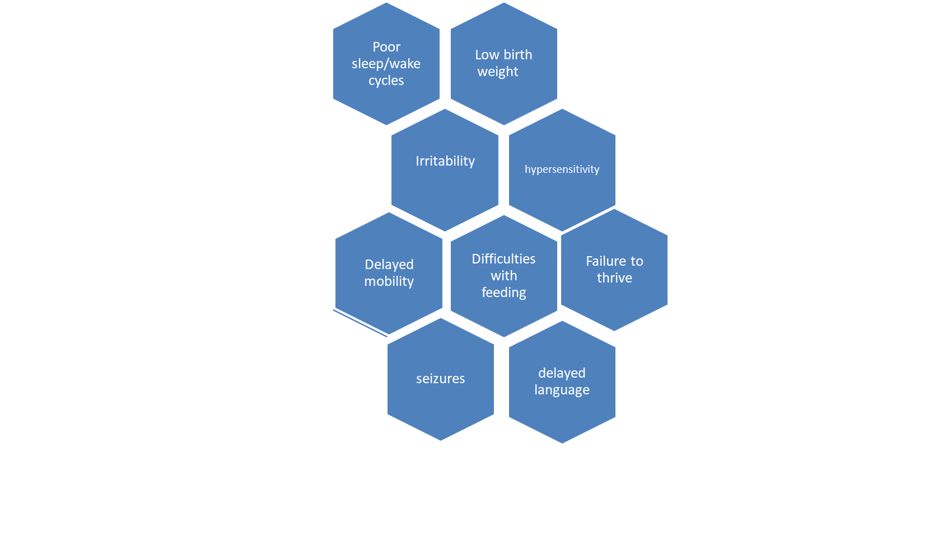
Signs and symptoms in 0-2 year olds
Notes:
General signs of “developmental delay” may be present. Lots of children will “catch up” once they are in safe and secure homes with key attachment figures (you as their adoptive parents!). However a minority of children will struggle more long term. Signs of developmental delay include:-
slow to babble and talk
not sitting, crawling or walking at the same stage as their peers
the “startle” response that we see in new born babies may continue and there could be exaggerated reflexes
increased or decreased muscle tone
problems with visual and fine motor skills which can lead to poor hand/eye co-ordination
some babies may also develop rocking or repetitive movements which MAY be due to brain damage
born prematurely
low weight and size for their age
Difficult to soothe and cry often
Problems with feeding
Don’t panic! Many of the above symptoms can be minimised or disappear completely as the child settles into their forever family.
Talk to your Health Visitor or GP if you are concerned about any of the above.

Slide 17
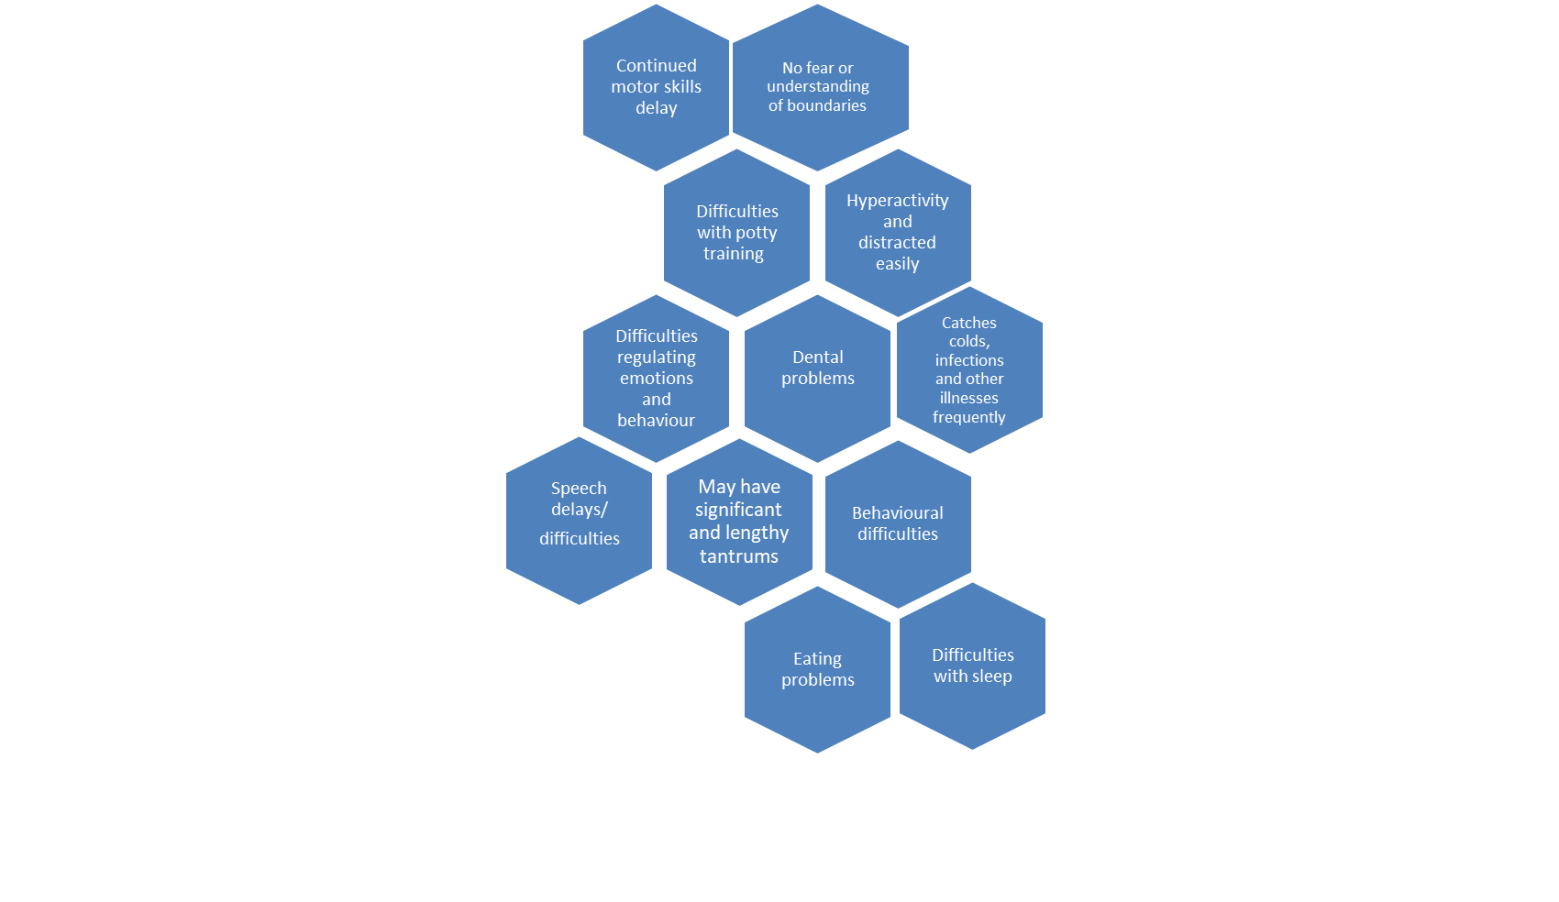
Signs and symptoms toddlers
Notes:
As with the previous slide, don’t panic! Lots of children will “catch up” once they are in safe and secure homes with key attachment figures (you as their adoptive parents!). However ongoing signs that might indicate FASD can be present include the points on the slide and:-
Delays with climbing, running, balance
Struggles to sit still and concentrate (so quiet time/carpet time in nursery may be a challenge)
Doesn’t find it easy to play with peers; prefers to play alone
Lacks fine motor skills to do tasks like put a straw into a drink carton
Talk to your Health Visitor or GP if you are concerned about any of the above.

Slide 18
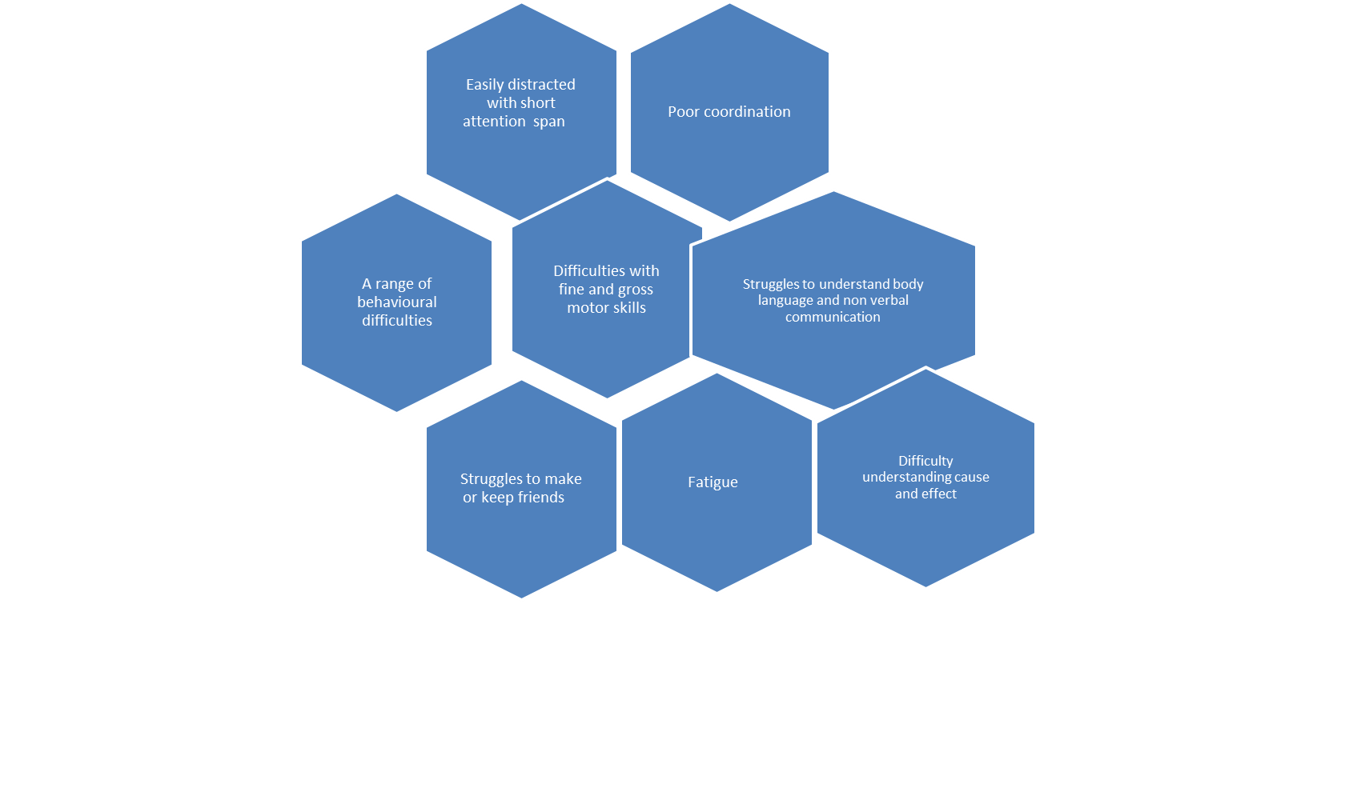
Signs in school age children
Notes:
School age children who have FASD may display some or all of the symptoms on the slide above. They may:-
Find it difficult to focus on classroom tasks and get easily distracted by other pupils around them
Continue to find it difficult to climb, run or balance as well as their peers
Fine motor skills like writing, drawing, cutting or threading may be challenging
They may struggle to read other people’s facial expressions and non verbal cues accurately
Frequent tantrums due to frustration
Unable to learn from consequence based behaviour management approaches
May find school totally exhausting and return home at the end of the day stressed, emotional and very tired

Slide 19
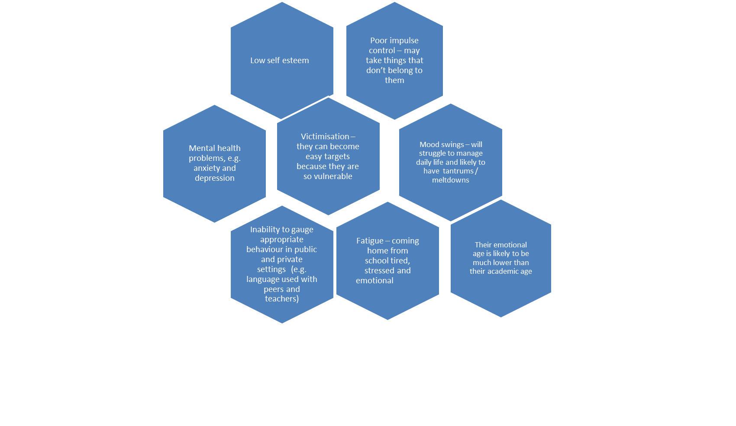
Symptoms in teenagers
Notes:
Although it is probably OK to let an average 14 year old catch a bus into the next town with her peers, a teenager with FASD may not have the skills to do this safely – they may lack problem solving skills and misjudge how to keep themselves safe.
Teenagers with FASD may be drawn into gangs.
Some teenagers are diagnosed with autism or oppositional defiance disorder.
The symptoms on this slide are not unique to teenagers with FASD. Lots of teenagers display some or all of these symptoms and do NOT have FASD. However the symptoms should be assessed alongside knowledge of mother’s alcohol use during pregnancy and signs and symptoms when the child was younger, too.

Slide 20
Why is it so difficult to diagnose FASD?
There is no physical “test”
Various diagnostic criteria and guidelines
Few practitioners feel able to diagnose/ lack of FASD clinics
It can be difficult to get a definitive history of birth mother’s alcohol use during pregnancy
Practitioners may be reluctant to label a child with this stigmatising disability
Concerns regarding lack of services if a diagnosis is given
Facial features become less easy to identify in adolescents and adults
Difficulties may become more apparent in adolescents and adults
Notes:
The first step is to go to see your GP – although she/he may not have had any training about FASD so you’ll need to explain why you think your child may have it. It is important to remember that the absence of facial features does NOT rule out FASD, especially if your child is older when you first suspect FASD.
It is likely your GP will refer you to a paediatrician or geneticist if FASD is suspected. It may be useful for you to do some “homework” to find out if there are any specialists in your area who have knowledge of FASD.
You may wonder why a referral is made to a geneticist if there is no physical “test”. It is because genetic testing needs to be done to rule OUT any other conditions which may present with similar symptoms to FASD, particularly facial features. These genetic conditions are NOT caused by the birth mother’s alcohol use during pregnancy.

Slide 21
Why get a diagnosis?
To get advice on behaviour management and other interventions to improve children’s wellbeing
In order to help families plan for the future
To prevent indirect consequence of the disorders, known as secondary disabilities – e.g. deteriorating issues with behaviour, social exclusion and some mental illnesses
Notes:
You may want to take a look at one of the other online courses “health and development” which also considers issues relating to developmental delay related to early trauma, neglect and Adverse Childhood Experiences (ACEs)

Slide 22
The future?
Despite 40 years of research gaps persist
Evidence continues to emerge to improve understanding and knowledge base of FASD
Diagnostic biomarkers?
Analysing correlation between SFF and patterns of neurological deficits
Improved screening, diagnosis and management
Notes:
There are still gaps in knowledge and evidence related to the diagnosis of FASD. Researchers and clinicians continue to study the effects of pre-natal alcohol exposure. Evidence continues to emerge that improves the understanding and knowledge base of FASD. For example diagnostic biomarkers are under investigation, as are additional tools to assess sensory processing and integration dysfunction, and sleep disorders in those with FASD. Databases containing diagnostic data will in the future be analysed for correlations between sentinel facial features and patterns of neurodevelopmental deficits. Updated evidence based recommendations for best practices in the diagnosis of FASD will lead to more efficient and effective care for affected individuals across their lifespan.

Slide 23
FASD has some positives too!
There are many positive aspects to the personalities and characteristics of a person with FASD including:-
Likes cuddles, cheerful and tactile
Friendly, outgoing, gregarious and tactile
Happy in an environment that accepts them and provides ongoing support
Loving, caring, kind, concerned, sensitive, loyal, faithful
Affectionate, compassionate, sensitive
Determined, committed, persistent
Spontaneous, curious, involved
Energetic, hard-working, athletic
Fair and co-operative
Likes to be asked to help
Highly verbal
Kind with younger children and animals
Able to problem solve with appropriate support
Concrete thinking
Strong visual memory
Ability to learn by doing (kinaesthetic learner)
Artistic
Musical
Mechanical skills
Interested in construction and gardening
Good sense of humour
Enjoys telling stories
Notes:
The information on this slide is taken from nofas.org (“National Organisation on Foetal Alcohol Syndrome”) based in the US.

Slide 24
Doing things differently
As parents, you may need to pay more attention to ensuring routines are in place and children are helped to prepare for their daily activities.
Think about your child’s emotional/social age rather than their chronological age may help.
You may need to continue helping older children, teenagers and adults with these daily living tasks.
Notes:
Think about your own child; what do they struggle with on a daily basis?
What adaptations have you made to reduce stress before school, at bedtime, during non-structured times, on holiday, etc.?
What else could you do to help them manage daily activities more effectively?
It’s important to remember that children with FASD and similar conditions may show age-appropriate development in some areas but not others
Visual reminders might be really helpful

Slide 25
Using visual reminders
Notes:
It is vital to bear in mind that each person is unique; what works for one child may not work for another. You are the expert in your own child.
It can be really helpful to get children to design their own visual reminders using emojis, photographs, their own drawings, etc.
Helping children with their organisational skills may help

Slide 26
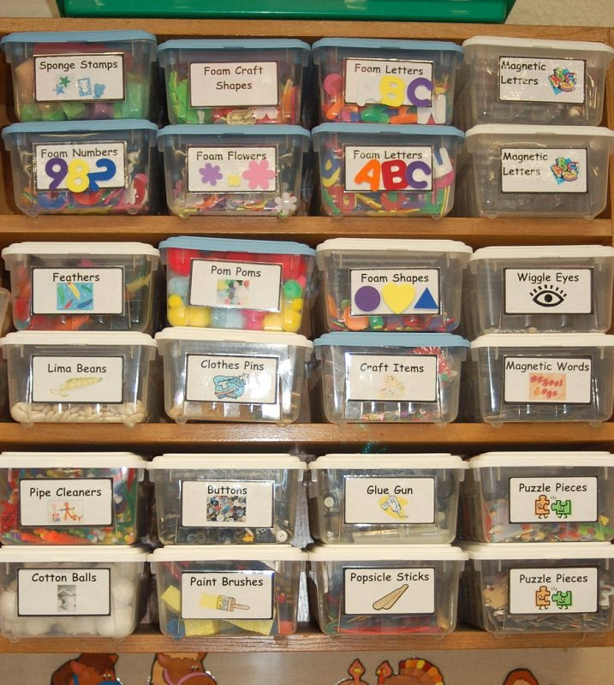
Helping with organisational skills
Notes:
Lots of children with developmental delays and FASD struggle with organisational and memory skills. So do lots of parents actually! Get your child to help come up with some ideas to organise their belongings, school books, clothing, etc. This can help avoid issues with finding things at short notice when time is limited and children’s stress levels are rising – and your own stress levels! The frequency and intensity of challenging behaviour can increase when parents and children struggle to organise themselves or provide predictability.
Some of the things that may help are:-
Labelling items
Putting similar things into groups (e.g. separate baskets/drawers for pyjamas, underwear, PE kit, school uniform)
Colour coding items (e.g. different coloured files for each school subject)
Using picture references (you may want to research PECS – Picture Exchange Communication System - which is a system used widely with children who have autism)
Although it can help to provide visual reminders and introduce system to organise every day items, children’s behaviour can still be challenging. Let’s consider this on the next slide.

Slide 27
Why may a child display challenging behaviour?
Sensory overload (e.g. large crowds, loud noises, changes to routine around mealtimes)
Getting frustrated with themselves or with others (helping a child to recognise what it feels like when they are starting to become angry or feeling overwhelmed can help)
Unable to effectively communicate what’s going on in their head (they may have limited expressive language but more commonly it is their receptive language which is immature). They may struggle to read body language – it can be helpful to do specific work with them on recognising social cues, facial expressions and other non-verbal communication
Need for stimulation – the majority of children with FASD also have ADHD. They struggle to sit still and stay focussed without fidgeting; providing them with something to fidget with in the classroom, for example, can be really helpful.

Slide 28
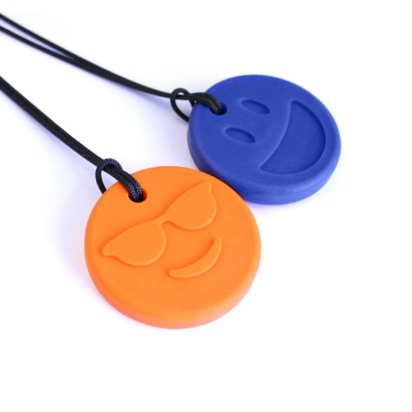
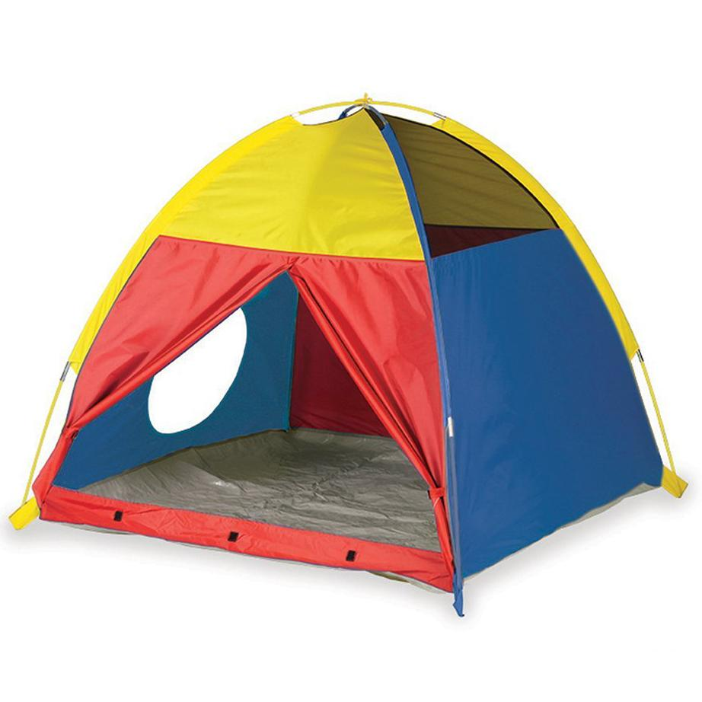
Ideas to help
Notes:
If a child struggles with bright light and gets distressed, offer sunglasses.
Use ear defenders in noisy environments.
Change lighting levels at home.
De-clutter rooms – if you don’t have time to put toys and abandoned clothes away in a child’s bedroom at bedtime, cover them with a sheet!
Don’t offer too many choices of clothes or toys at any one time.
Use a traffic light system to help children understand when they are getting angry or overloaded.
Offer Chewelry for a child who needs to bite/chew to stimulate/calm themselves.
Offer a safe space (e.g a tent) for child to go to, to avoid over-stimulation.
Give a child who bites/spits a thick drink to take through a straw.

Slide 29
More ideas to help
Ask a child to repeat instructions back to you in their own words to check they’ve understood; repeating back rote style does not necessarily equate with understanding.
Give one instruction at a time, in a concrete format; e.g. “Tell me what you are thinking about while you look at that photo of yourself” rather than “Penny for your thoughts”.
You can help children understand physical boundaries/personal space by using coloured tape to mark out a child’s space at the dining table or desk in school
Some children have a genuine difficulty in understanding ownership and often get into trouble for taking things that aren’t theirs. These children need regular reminders that they need to ask before taking something, and that somethings can be borrowed but others need to be paid for
Notes:
Remember that we (and teachers!) might get “wound up” by a child fidgeting but for some children they NEED to do this in order to focus. Talk with school about making accommodations for this (but DON’T send them into school with fidget spinners without checking whether that is an acceptable fidget toy!)
You may find it useful to ask for a referral to an Occupational Therapist.

Slide 30
What if you have a child who struggles with food?
The most important thing is to consult a medical professional if you are at all worried about feeding issues, including weight loss or if the child isn’t growing.
The child may have problems with their sucking reflex.
They may take a long time to eat and then regurgitate their food.
It’s really important to stick to strict routines around food/ mealtimes.
Make sure you use the same bottles, teats, bibs, plates, spoons, etc.
If a baby is easily distracted while feeding, consider going to do it in a quiet, darker room.
Avoid having the TV or music playing while a child is eating.
Consider whether children with sensory issues will find certain foods difficult to eat due to texture, flavour, etc.

Slide 31
It’s a nightmare getting my child dressed – what can I do?
If they have problem with fine motor skills they might need help with buttons, zips, laces.
They may not be a good judge about whether to wear warm clothes in winter and less layers in summer!
Consider whether cuffs, waistbands, collars, lace up shoes etc. can feel overly restrictive.
Some children may even find clothes that are too bright over stimulating.

Slide 32
Keeping a child with FASD safe
A child with FASD is likely to need closer supervision because socially and emotionally they can be at half their chronological age. We need to meet their safety and care needs based on their social/emotional age.
A hyposensitive child may not feel pain as expected; they may touch the fire and not pull away quickly because they don’t feel the heat in the way others would. They may not feel the need to add cold water to a hot bath as they struggle to judge the water temperature.
It’s important to look for other signs of pain that a child may not be able to tell us about, e.g. swelling, bruising.
Notes:
To help you think about chronological v. social/emotional age, ask yourself the question “Would I let my 14 year old child get a bus into town with his friends? Would I let my 7 year old do the same thing?”

Slide 33
A final reminder!
You may have done this course because you suspect your child has FASD.
FASD can ONLY be formally diagnosed if there is clear evidence of maternal alcohol use during pregnancy AND after genetic testing has been done to rule out other conditions.
Although a formal diagnosis MAY help, you are still parenting the same child. The most important things to do are
Reflect on what your child CAN do, rather than what they can’t
Consider WHY they may struggle in comparison to their peers
Parent them in a way that will help you develop a secure relationship with them
Provide many opportunities for play and joyful moments
Seek professional advice from GP, Health Visitor, School Nurse, CAMHS, social services, etc. if you have concerns

Slide 34
This course is part of a series developed by the National Adoption Service to support adopters after approval.
These can be accessed at the National Adoption Service website.
Please talk to your adoption support team for further information

