Slide 1

Achieving More Together / Cyflawni Mwy Gyda’n Gilydd

Slide 2

The NAS Post Adoption Training and Development Framework
These materials have been developed for the National Adoption Service for adoptive families
Their purpose is to provide a learning and development resource for adopters post placement
These tools can be used by groups or by individuals.
There is lots of information in the notes below each slide so it is important to read these too as they provide much more information, and some useful ideas for more reading.
Notes:
These courses may be useful for professionals but their primary audience is adopters, and their families.
We have tried to include sufficient information for those self learners looking at this on its own. However if the material doesn’t seem to ask your adoptions support team for some help in getting to grips with the issues.
By its very nature a short course will never cover all that is known on a subject. The courses have been developed by experienced social workers and adopters who have pooled their thinking about what might be useful. There is always more to know, and some authors who will seem useful to you, others less so.
Try out some new thinking but if it’s not helpful ask other people for ideas and other training courses, books etc– friends, colleagues, other adopters, helplines, your adoption support service. By reading around you will come across someone who talks to your experience.
If delivering as a course, consider
using an ICEBREAKER
how you will deal with INTRODUCTIONS (of yourself and participants) – e.g. Round room, introducing one another, show of hands
Whether a REGISTER needs completion
Whether BADGES will be used
HOUSE-KEEPING/GROUND RULES (e.g. fire drill, fire exit, refreshments, parking, mobile phones, confidentiality, safe-guarding, let everyone speak, everyone is entitled to their opinion, timekeeping, opportunities to ask questions/discuss)
Arrangements you will have in place if a participant becomes DISTRESSED or needs to leave the training room if they are finding the topic emotive
If delivering on a one-to-one basis consider
GROUND RULES (e.g.. confidentiality, safe-guarding, everyone is entitled to their opinion, timekeeping)
Explain course in context of the other 2 hour courses in the National Adoption Service online training suite and wider training/support available in Wales for adoptive families

Slide 3
Looking after yourself..
Notes:
This is a session that focuses on the adoptive parent and their lived experience with a child. We know that living with traumatised children can impact on the parent’s well-being in surprising ways. The key is to learn about this and not to feel it is only You…learning about the concept of Blocked Care and Secondary Trauma is the first and main step to understanding that this is a normal reaction and one that when recognised, can prevent you becoming overwhelmed. If you identify with the issues raised in this session we suggest you talk about it with others in your support network. Spending time with friends/doing things you like is the second most useful way to keep yourself well.

Slide 4
What is this module about?
This module will help you to:
Think about how living with an adopted child can impact on your well-being in surprising ways
Understand what is meant by ‘Secondary Trauma’ and ‘Blocked Care’ and how self- awareness is really important
Recognise if this is an issue for you or members of your family
Consider ways for looking after yourself

Slide 5
Consider this..
Sometimes living with a child who has poor early years experience can make you feel awful about yourself, feel different to how you usually feel, do things you would not normally do, lack the clear thinking you would normally have..

Slide 6
Reflection
Think back to when you were first considering adopting a child:
How were you feeling?
What were you hoping for?
How was your child described?
How were you picturing yourselves as a family?
Notes:
This reflection aims to bring up adopters’ initial feelings of hope and joy in wanting a child in their family, along with the apprehension and expectations.
Also to consider what they learned about the child when first considering the match and their hopes about what they aimed to offer the child.
In a group setting this should be done in small groups so adopters feel able to share personal thoughts and feelings..it requires facilitators to provide a safe and open environment where adopters feel comfortable sharing this information.
Note on flipchart main issues that come up then move to next slide
A clever example by Emily Perl Kingsley: ‘Welcome to Holland’ 1997
When asked to describe the experience of raising a child with a disability she says it is like planning a trip to Italy, making plans, learning the language etc and then getting off the plane and finding that you have landed in Holland and you have to adapt to this country instead!! You can apply the same principle here!

Slide 7
Stress Factors
Expectations
The emotional high of being matched and having a child placed
The very unique stresses of the adoption process itself
The lack of information shared with you about your child’s history
Feeling let down by your agency
Reliving fertility issues
Identifying with the birth family’s feelings of loss
Feeling angry about what your child has suffered
The challenges of parenting a child who is traumatised and has life experiences that are not shared by the adoptive parents.
The normal new parenting issues
Notes:
If you ask a group these are some of the stress factors that may be suggested:
Expectations can be the cause of major feelings of disillusionment/dissatisfaction. Expectations of the process itself, of oneself as a parent, of what the child will be like and what they will bring to the family, of family and friends and of society in general can all be contributing factors.
The emotional high of being matched and placed with a child. Once the dream of having, or completing, a family has been realised, adopters can feel disappointed and guilty at feelings of deflation or anticlimax
The very unique stresses of the adoption process itself.
Reliving fertility issues. Adopting a child can trigger unresolved thoughts, feelings and emotions about personal fertility issues.
Identifying with the birth mother’s feelings of loss. There can be a sense of ‘stealing’ another woman’s child, which can create a bitter-sweet mix of feelings ranging from satisfaction and attainment (at adopting a child) to trauma and loss (at ‘taking’ him/her from someone else).
The challenges of parenting a child who is traumatised and has life experiences that are not shared by the adoptive parents.
The normal new parenting issues, such as financial responsibility, lack of sleep, increased family responsibility, major lifestyle changes, and relationship issues
It is an emotional rollercoaster!!

Slide 8
So you come to being an adoptive parent with hopes and expectations and we have talked about the stress factors.
Why can living with an adopted child make you feel odd?
The key to understanding this is to recognise that the way a child feels as a result of their adverse experiences will impact on how you feel as the adult caregiver

Slide 9
Just a reminder:
Because of their poor early experiences your child may:
struggle with feeling both physically and emotionally safe
have great difficulty regulating their emotions
struggle to find words and reasons for their feelings
This may impact on you
It will impact on lots of people in this way
Notes:
Because we now know of the impact of early maltreatment the demands on adoptive parents are considerable
Children struggle with feeling both physically and emotionally safe (Golding 2008; Hughes & Baylin, 2012),
Have great difficulty regulating their emotions (Cairns, 2002), and
Struggle to find words and reasons for their feelings (Beeghly & Cicchetti, 1994).
As a result, children can present difficult and challenging behaviour which requires a therapeutic approach to parenting from adopters in order to promote developmental recovery
The parenting approach has to be different and one that is adapted to meet the child’s needs which may mean not using discipline techniques in the usual way
Love is not enough?
This is immensely challenging and requires adopters and those who support them to have a good understanding of trauma and the demanding reality of caring for traumatised children.
Research into Disruption in 2014 highlighted the struggles of adoptive parenting including the high incidence of Child to Parent Violence
The research document is available online. https://www.gov.uk/government/publications/beyond-the-adoption-order-challenges-intervention-disruption
There is a smaller study also done in Wales with similar findings https://www.adoptionuk.org/sites/default/files/documents/150603adoptionreporten.pdf
Recent surveys by Adoption UK have also highlighted this view that adopters are facing particular challenges with their children’s behaviour
More up-to-date survey which confirms what Selwyn’s study found - https://www.adoptionuk.org/news/bbcadoption-uk-survey-snapshot-modern-day-adoption

Slide 10
Empathy
Being empathetic is a real strength, a key quality for an adoptive parent… however it can also be a risk factor for your own well-being when re-parenting a traumatised child
Notes:
Some quotes from adopters: “ as adoptive parents we have often discussed that we have gone through a similar process – the loss of an ‘ideal’ family. Everyone around the table on this particular course I was at, they had gone through that. It’s given me a bit of insight about the child –what on earth were they expecting from us!!”
“ Sometimes this is really difficult when you are living with children who have catastrophic thinking” “ sometimes as a Dad, trying to find something positive to say is really difficult, even though I know it’s good for him. I can laugh about it sitting here, but sometimes I bore myself at home, always having to deal with negative behaviour”
“You need to build resilience in yourself as well”

Slide 11
Empathy
Sympathy
Compassion
Think about the meanings of these words.
Notes:
Thinking about the differences between empathy and compassion can be part of a toolkit for helping when feelings are overwhelming. It doesn’t mean that an empathetic stance, as supported by Dan Hughes’ PACE model is not a useful every day approach to parenting.
Groups might find it useful to do the following exercise or you may want to reflect on this as an individual. The process of thinking about these concepts may help you to understand what is happening to you. How did you find it?
Discuss the meaning of the words Empathy, Sympathy and Compassion : what might they each look like in the context of parenting a child who has suffered trauma?
Empathy means 'the ability to understand and share the feelings of another', whereas sympathy means 'feelings of pity and sorrow for someone else's misfortune'
Compassion =‘In contrast to empathy, compassion does not mean sharing the suffering of the other: rather, it is characterised by feelings of warmth, concern and care of the other as well as a strong motivation to improve the other’s well-being. Compassion is feeling for and not feeling with the other’’ Singer and Klimecki 2014
There is an interesting argument for compassion as opposed to empathy in Paul Bloom (2016): The case for rational compassion’ where he identifies compassion as the sentiment that is linked to reward and satisfaction and thus less harmful for the person feeling it. In his view empathy engages the person in the feeling which makes them more vulnerable and in turn more vulnerable to secondary trauma. This would be a useful discussion to have.
Adoptive parents who may be in this mode of parenting i.e. Blocked care due to secondary trauma or compassion fatigue will need:
An acknowledgement of what they are feeling
A break
Compassionate support – non judgemental and understanding
- aimed at helping them to understand what is happening to them by identifying this cycle which in turn will stimulate the thinking brain (pre-frontal cortex) to respond and this will switch on their compassionate care of the child again.
Sarah Naish describes in her book, ‘Therapeutic Parenting in a nutshell’ that support for the adoptive parent can shift the parent’s brain from defence mode. This doesn’t mean parenting without empathy it means that if you are being overtaken by the empathy and entering ‘secondary trauma’ it may be useful to consider a more ‘compassionate’ perspective which in turn may help shift your thinking and you become better able to regulate your feelings
Reignite your capacity for empathy and self regulation
Lowers stress hormones blocking the brain
We’ll talk about this more on the next slide

Slide 12
Stress
Automatic shutdown of pre-frontal cortex
Not fault of parent
Can be complicated by parents’ own attachment history
Can lead to defensiveness, feeling disconnected, hopelessness
Loss of empathy
Notes:
Stress causes cortisol to flood the brain systems including inhibiting the pre frontal cortex as the brain is preparing to defend
Without the thinking brain or pre-frontal cortex working properly the parent is forced to react from a defensive emotional state
One’s own attachment history can be a factor e.g. One’s internal working model: feeling worthless, not good enough, maybe my infertility is a sign that I should not have been a parent....
This emotional stance can cause the parent to feel hopeless and defensive...losing empathy with the child
This will escalate the problem
‘The adopters have borne the child’s projections and trauma for so long that they themselves have become emotionally abusive or paralysed and passive victims from the child’s violence.’ (Disruption Research)

Slide 13
The Brain
Pre Frontal Cortex
Limbic system
Amygdala
Notes:
So what’s going on with Secondary Trauma?
Dan Siegel talks about brain development and the impact of trauma means that children can ‘flip their lid’ more readily. At its most simple, secondary trauma is the impact of this on the caregiver who is in an attachment relationship with someone who is flipping their lid.
Jon Baylin talks about this in Brain Based Parenting by Hughes and Baylin. He describes how in SECURE relationships the limbic system/ amygdala promotes development of two-way connections to the prefrontal cortex – which happens 0-18months
This is essential for self-regulation
Good parenting develops secure attachment and a “good lid” ! in the Pre-frontal cortex
Stress suppresses pre-frontal cortex development which is responsible for
executive function i.e. thinking clearly, accessing memory, rehearsing and planning etc., self-regulation and meaning making
In TRAUMA the limbic system/ amygdala is activated by high levels of stress. This can be the experience of children who have suffered neglect/trauma. This causes overactive defensive reactions of Fight Flight Freeze.
Without a good, well developed Pre-frontal cortex, children flip their lids AND so can their PARENTS!!! The stress response blocks the capacity of the child to think and process events, hence they flip. This has a knock-on effect on the adults in an attachment relationship with this child. They can become as stressed as the child and then lose their own capacity for engaging rational thinking and emotional self regulation. This is not a failure…it is a natural consequence of living with a traumatized child. So taking responsibility for your own self care is important.
The aim of good self care is to remain or return to a state in which the parent is aware of the process by which their child can drive them towards inappropriate responses of anger and frustration. By maintaining your own self regulation you are not dysregulating in response to the child’s trauma, you are not letting it get to you. This is an inevitable consequence and not because you are failing as a parent.

Slide 14
Trauma is catching!
Secondary Trauma is “the natural consequent behaviours resulting from knowledge about a traumatizing event experienced by a significant other.
It is the stress resulting from helping or wanting to help a traumatized or suffering person”
Kate Cairns

Slide 15
Secondary Trauma
Kate Cairns suggests look out for changes in:
  Emotional function e.g. Anger, tearful, disengaged
  Health e.g. sleep pattern appetite, illness
  Physiological arousal e.g. Nightmares, reduced concentration, impaired memory
  Avoidance of engaging with the child’s trauma

Slide 16
Secondary Trauma Looks like.
intrusive thoughts
chronic fatigue
sadness
anger
poor concentration
second guessing
detachment
emotional exhaustion
fearfulness
shame
physical illness
Absenteeism
Notes:
Emotional function
Anger, tearfulness, fearfulness, disengagement
Health
Sleep patterns
Eating and Drinking
Physical illnesses
Levels of physiological arousal
Startle response, nightmares
Hypervigilance, reduced concentration, reduced memory
If disorder sets in day to day functioning is impaired and clear changes in behaviour become apparent, such as:
Missing or cancelling appointments
Being less able to make use of support networks
Losing the capacity to self care and self organise
Feeling isolated, alienated and unappreciated

Slide 17
Secondary Trauma
Avoidance is an understandable response to stress.
It can mean:
Closing down sensitivity to the child
Being unable to describe the child positively
Denying aspects of the child's experience
Avoiding talking about difficult emotions
Avoiding situations or triggers that remind us of them
It can impact on performance and morale
Notes:
Secondary trauma is not permanent… it is treatable

Slide 18
Blocked Care
Blocked care is used to describe parent’s emotional, physical and biological responses to children’s insecure attachment behaviours resulting in parents no longer able to make a healthy connection to the child (Hughes & Baylin, 2012).
Blocked care’ describes ‘how stress can suppress a well-meaning parent’s capacity to sustain loving feelings and empathy towards his or her child’
It stems from a need for self-protection and defensiveness and fosters a reactive style of parenting that is narrowly focussed on the immediate behaviour and most negative aspects of the child.

Slide 19
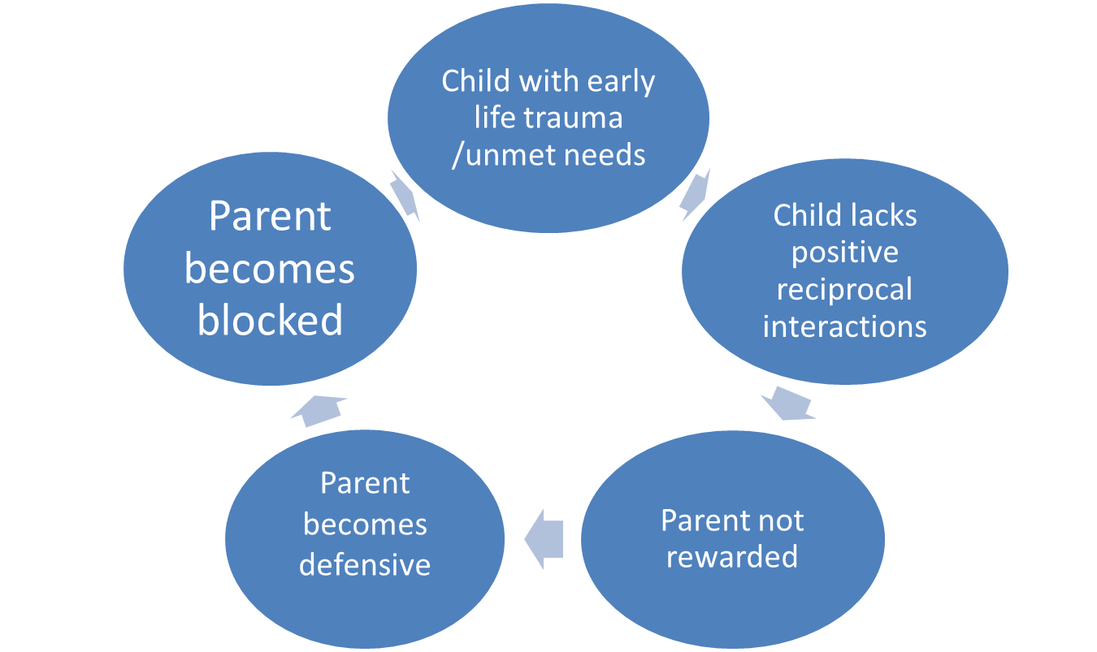
Blocked care/Compassion fatigue
Notes:
Avoidance and blocked care: these points summarise what is happening
Parenting is in survival mode – the parent is struggling to cope
Approach system is OFF – parent is not engaging with the child’s needs
Defence system is ON – they are reacting in defensive mode
Child reading system is narrowed – parent not able to engage with what is going on for the child e.g. the child may be behaving as a result of suffering intense anxiety
It’s personal – parent starts feeling rejection instead
It’s ME versus YOU – the situation develops into a competitive one, a power struggle…
The lid is flipped – Pre-Frontal Cortex is shutdown – both parent and child become reactive and the situation escalates
Amygdala responses dominate – emotions are high and child reacts with their learned strategies for self defence
Blocked care can end up in a cycle where child with unmet needs continues to have their needs unmet as the parent becomes blocked..this in turn will reinforce the parent’s blocked approach
--
This situation needs unblocking
Compassion fatigue is another similar term and has been a focus of some research in other fields eg. Nursing profession
A study of foster care and compassion fatigue was done in Bristol by Ottoway and Selwyn in 2016: this study highlighted the impact on foster carers of parenting traumatised children and the similarities can be drawn with adoptive parenting
http://www.bristol.ac.uk/sps/research/projects/completed/2016/compassion-fatigue-in-foster-carers/

Slide 20
Components of Blocked Care
Burnout
Primary trauma
Secondary traumatic stress
Inhibited Compassion satisfaction
Compassion fatigue
Notes:
These are the components identified by the Ottoway and Selwyn study
Burnout is obvious where the continuing demands cause fatigue in the parent
Primary trauma is a risk that is evident particularly where the traumatised child resorts to violence and aggression against family members
Secondary trauma is where the parent over empathises with the child’s trauma so that they become swamped with these feelings
Compassion satisfaction is the reward factor that a parent in a secure attuned connection with the child feels and is the main factor that keeps parents going..when this is inhibited by the factors above it changes into fatigue and blocked care

Slide 21
What can we do?
Learn about Secondary trauma and Blocked care: Be aware of impact of own feelings/thoughts on behaviour
Stress management techniques e.g. Mindfulness
Look after ourselves
Use support systems: formal and informal
Consider requesting support as a carer
Consider therapy where necessary
Notes:
How to respond:
Training: learning about secondary trauma reduces incidence/ learning stress management techniques e.g. mindfulness, Cognitive behavioural therapy – targeting automatic negative thoughts or negative self talk
Support: formal and informal networks can increase resilience
Supervision: with your social worker: use this opportunity to reflect and help to identify signs and symptoms
Self care: making time for oneself/each other
Therapy:
Cognitive therapy can address distortions of thinking patterns
Acceptance and commitment therapy is a form of behavioural therapy that uses acceptance and mindfulness strategies to increase psychological flexibility
Behavioural therapy may be needed for any coping strategies that have become unwanted habits
Counselling may be needed to address any triggered unresolved trauma
Couple counselling can be considered if issues have had an impact on relationship
Systemic therapy can address whole group dysfunction

Slide 22
Thoughts and Feelings
Thoughts
Feelings
Behaviour
Notes:
There is an exercise from Cognitive Behaviour Therapy/ Mindfulness that is relevant here on how stress factors can impact on our thoughts which can become negative and self defeating. For example when a child becomes aggressive towards me I can think ‘it is my fault, I should never have become a parent, I cannot do this’. This will affect how we perceive a situation and more often we become defensive or aggressive, internalising and blaming ourselves and then withdrawing, or denying our own responsibility and attacking the other person in defence of oneself. When we try to alter these negative thought patterns we can adopt a more positive stance, e.g. ‘This is not my fault..this is not his fault, he is afraid and needs to express it. This is something I can help with, I have had training on this and I can make a difference.’
Automatic negative thought patterns are evident when you hear yourself generalising, overreacting, dramatising the little events, only perceiving the negatives, focussing on what should happen rather than on what is happening, focussing on yourself and your perceived negative qualities rather than looking at the child’s perspective..
When you become aware of your negative self talk it is useful to try to work on changing how you are thinking to something more positive and see the difference.
Adopt a special ‘mantra’ you can say to yourself during these moments and use this to calm yourself down and try to look more rationally at the situation.
There are many sites on the internet that explain this concept and you can practise the exercises.
Search for Cognitive Behaviour Therapy
Search for Negative Self Talk

Slide 23
Key Message
Reacting is an emotional response
Responding requires engaging our thoughts
Stress will limit our ability to think

Slide 24
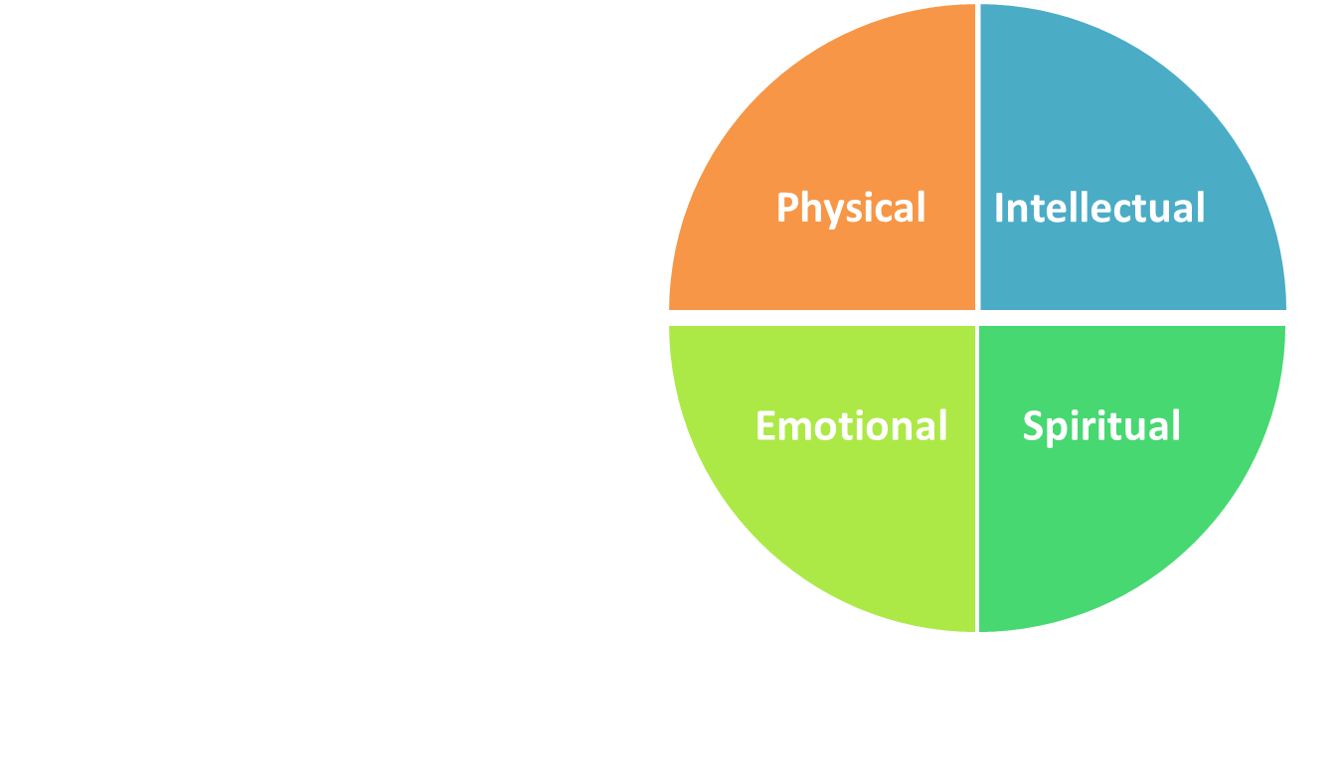
Self Care – ‘PIES'
How do you look after yourself?
Think about the 4 dimensions and write down activities that work for you.
Are the sections of your ‘pie’ the same size? Do they vary over time?
Notes:
It is important adopters look after themselves along the four spectrums: physical, intellectual, emotional and spiritual.
This exercise is useful to consider the various areas and focus on each at regular intervals so all areas are considered in keeping oneself strong and healthy

Slide 25
Summary
Caring for a traumatised child or a child who has suffered some early maltreatment is difficult.
It can sometimes cause you to feel low, even depressed, possibly develop secondary trauma and cause you and your child to experience blocked care
It is important that if you identify with any of the issues raised in this module that you seek support

Slide 26
This course is part of a series developed by the National Adoption Service to support adopters after approval.
These can be accessed at the National Adoption Service website.
Please talk to your adoption support team for further information

