Slide 1
Achieving More Together / Cyflawni Mwy Gyda’n Gilydd

Slide 2
The NAS Post Adoption Training and Development Framework
These materials have been developed for the National Adoption Service for adoptive families
Their purpose is to provide a learning and development resource for adopters post placement
These tools can be used by groups or by individuals.
There is lots of information in the notes below each slide so it is important to read these too as they provide much more information, and some useful ideas for more reading.
Notes:
These courses may be useful for professionals but their primary audience is adopters, and their families.
We have tried to include sufficient information for those self learners looking at this on its own. However if the material doesn’t seem to ask your adoptions support team for some help in getting to grips with the issues.
By its very nature a short course will never cover all that is known on a subject. The courses have been developed by experienced social workers and adopters who have pooled their thinking about what might be useful. There is always more to know, and some authors who will seem useful to you, others less so.
Try out some new thinking but if it’s not helpful ask other people for ideas and other training courses, books etc– friends, colleagues, other adopters, helplines, your adoption support service. By reading around you will come across someone who talks to your experience.
If delivering as a course, consider
using an ICEBREAKER
how you will deal with INTRODUCTIONS (of yourself and participants) – e.g. Round room, introducing one another, show of hands
Whether a REGISTER needs completion
Whether BADGES will be used
HOUSE-KEEPING/GROUND RULES (e.g. fire drill, fire exit, refreshments, parking, mobile phones, confidentiality, safe-guarding, let everyone speak, everyone is entitled to their opinion, timekeeping, opportunities to ask questions/discuss)
Arrangements you will have in place if a participant becomes DISTRESSED or needs to leave the training room if they are finding the topic emotive
If delivering on a one-to-one basis consider
GROUND RULES (e.g. confidentiality, safe-guarding, everyone is entitled to their opinion, timekeeping)
Explain course in context of the other 2 hour courses in the National Adoption Service online training suite and wider training/support available in Wales for adoptive families

Slide 3
Attachment theory and its relevance for parenting adopted children

Slide 4
Learning Outcomes
By the end of this module you will have learnt..
What people mean when they talk about attachment theory.
How attachment theory can help us understand how children’s brains develop.
Why this is important to children's development and behaviour later on.
How these ideas could support adoptive parents to build relationships with their children
Notes:
Why look at this course?
You will have touched on Attachment theory during your Preparation course and your assessment. It is useful to revisit this now you are actually parenting your child.
Attachment theory is a huge subject and when you are busy being an adoptive parent it can be hard to understand why this is relevant and why would you choose to make time to look at this. In a nutshell it’s because attachment theory can be a really useful tool in helping to understand why children behave as they do and why adopted children may respond differently to other children. It also helps us to think about how our parenting can impact upon their emotional wellbeing both now and in the future.
Attachment Theory helps us to understand what needs to happen for the healthy development for infants.
Attachment theory informs many of the approaches to behaviour and building relationships at the current time.
Whether this is thinking about
How children experience the transition from foster to adoptive families,
Helping children have positive contact experiences
Why it can be exhausting being an adoptive parent
And sometimes why its hard to love your child, or to get them to feel loved by you.
This is a short course and so its only the tip of the iceberg! It doesn’t go into the details of how we can parent differently, other courses look at that area. This is just the start
Understanding the theoretical base that sits behind the more practical advice and information that's out there can mean that you are better able to reflect on why some things work for you and your child, and other things don’t. The hope is that by doing so you can adapt your thinking and try out new ideas. It can also help when you need to talk to other professionals, especially when you want them to do something for you’re and your child.
If you have a question that isn’t answered here just remember that you can pick up the phone and ask – other adopters, your adoption support service or voluntary sector help lines such Adoption UK and AFA Cymru. There's lots of information about attachments and, behaviour and relationships on line and we’ll signpost some of the things we've found useful too.
This module is more useful if paired with the Health and Development course within this suite.

Slide 5
Adoptive parents writing these materials want to acknowledge that it can be tough!
“I found it helpful when someone said ‘Aiming for perfection is not good enough; good enough is good enough’”
That's ok – we don’t always get it right – after a tough day, just remember that you can start again tomorrow!
Notes:
So why is it tough? Why might adopters find it difficult to parent their adopted child?
Consider your own situation as an adoptive parent. What are the challenges you face? How does your child behave that may cause you some concern? Are you fully aware of their early experiences and are you confident you are parenting in an appropriate way?
There are many factors involved in behaviour. Children will behave in a certain way because of:
Genetic make-up
Personality traits
Pre-natal experience
Developmental issues
Any medical factors e.g. ADHD
Situational factors e.g. part of a large sibling group
Environmental factors
Community influences
Early experiences
Separation and loss
When you consider these along with triggers that may be affecting the child in that moment, or they are feeling ill or worried with something on their mind…as parents we need to be experts at deciphering what is going on!!!!!

Slide 6
Why is attachment theory helpful for adopters?
Using attachment theory can help us to understand how children make relationships in the here and now, by better understanding their past experiences and how these have impacted their core identity, social and emotional development and brain development (see Health and Development course).
If the adults around a child can share an understanding of how a child experiences the world, and develop a shared approach to supporting the child and responding to any difficulties, then trusting, secure relationships can be built and outcomes will be improved.
Notes:
Using an understanding of attachment theory to develop a framework for understanding a child's behaviours in the here and now can help us to develop ideas about the ways in which we can respond. Most children who are adopted have not had their needs met in this way in their early days weeks or months and these unmet needs can drive their behaviour in the here and now. Parenting responses that are targeted at meeting those unmet needs about safety and closeness are generally more successful in the longer term that those responses which take the behaviour at face value.
Exercise:
What are a child’s fundamental basic needs?
There is a useful exercise that helps to consider what a child needs and what they may then have missed. It creates a visual image that can be effective.
Thinking about your own child and their early experiences write down on pieces of paper or post- its what their basic needs are… These will include food, comfort , shelter, holding, fun, smiling faces…. Try to consider all the detail. Think about this in the context of your child’s age – what would a child of that age need? Make a wall of the relevant bricks.
Now think about your child – what did they lack? Remove things they didn’t have – is the wall still stable? Probably not.
It’s a helpful way for some people to get a visual idea of what the gaps in these basic requirements for healthy development mean ie no matter how well you build a subsequent wall – if the foundations are unstable there can be issues that arise later on.

Slide 7
Child’s Basic Needs
Self Actualisation
Esteem
Love/Belonging
Safety
Physiological
Maslow:
Notes:
Attachment theory give us an explanation of how a child’s early needs are met through the interaction with the primary person caring for them.
Maslow’s theory about the hierarchy of needs is useful to consider in that if a child has their basic physical needs met, they then need to be kept safe before they can develop the capacity to form loving relationships and feel they belong. This in turn will help them to develop self –esteem so they can go on to achieve self-actualisation, forming their own dreams and ambitions and reaching their potential. Keeping this order in mind is useful when considering how a child’s early experiences have met their needs or not which relates to the building of the wall.

Slide 8
What do we mean by attachment?
“Attachment is formed through a consistent caring relationship between adult and child, activated as a result of stress (physical needs, threats, interrupted relationships etc) and enacted through physical care involving physical closeness and body contact which meets the child's basic needs for physical and emotional comfort. Hallmarks are reciprocity and continuity”
Beesley 2010
Notes:
Attachment Theory describes interactions between infants and children and the adults who look after them.
It tells us that the quality of the early years experience of caregiving relationships and their experience of separation and loss of caregivers are both significant in influencing how children see themselves and how they understand and anticipate what might happen when making relationships with others. Through the process of having their needs met children develop trust, communication, security and a sense of self at a very fundamental level.
There is lots and lots of information out there that will give you the basics of attachment theory. The NSPCC Brain Building video is a useful basic explanation about how brain development is impacted by early caregiving. Its is accessible through their website. Its based on work undertaken by Harvard Child Development Centre and for those who are looking for a more information. You will find many people on YouTube explaining the fundamentals of attachment theory and how these interaction build emotional health, and also contribute to brain development.
It’s a dynamic process, that also has an affect on the caregiver. When people are talking about what gets called reciprocity they mean the dance of the interaction between the adult and the infant/ child. So for the child they learn that their needs will be met, and they are helped to master managing their emotions by doing this alongside the caregiver.
For the caregiver its that warmth, its feeling that satisfaction and reward of having comforted and provided for and the baby. Things like being greeted by their smile, the flip in your stomach when you see this. It can build your confidence. Physiologically it’s a triggering of your serotonin – it makes you feel good, so you want to do it again!

Slide 9
Attachment and brain development
Attachment is important because what we know is that a baby’s brain development is affected by the parenting they receive.
As brain imaging technology has developed we have become more aware of how these early relationship impact on brain development.
Positive interactions support the development of neural connections.
Notes:
There are some good online resources that explain this. Some of our favourites are
Harvard University Child Development Centre – they do a series of videos, and other literature about brain development, and what they call Serve and Return Interactions.
The NSPCC Brain Builders video is good and can be found online., it provides a really clear explanation of how brains are built through early years experiences and social interactions. It talks about the need to help children's healthy development and this is what is hoped will be the outcome of your adoption. It also talks about toxic stress – something we will return to later on.
www.nspcc.org.uk/.../children-in-care/infant-mental-health
This is also explained in the Health and Child Development module.

Slide 10
The Caregiving Cycle
When the baby / child displays a need
The caregiver responds in a timely and consistent manner
The baby/ child feels safe and is able to engage in other things e.g. play, exploration.
This is called a the caregiving (or arousal relaxation) cycle.
When needs are met in this way secure attachments develop and infants/ children are free to explore their environment.
Notes:
In secure attachments people talk about the “dance of attachment” – when caregiver and child are focused on each other, responding appropriately to each other’s cues (behaviours) and moods. This is referred to as attunement, and through this process the child learns to regulate their own behaviour and feelings.
Characteristics of sensitive caregivers: empathetic, accepting, sensitive and available – this links directly to the domains of the Secure Base Model developed by Gill Schofield and Mary Beek at the University of East Anglia (why not take a look at the module on this). You can access their www.uea.ac.uk/providingasecurebase/the-secure-base-model

Slide 11
Secure Attachments
Secure infants and children who have experienced secure base parenting that is
- Available, mind-minded, attuned, and sensitive to their needs
- Supportive of exploration, effectiveness and co-operation
- Builds self esteem
Through these interactions babies and children also develop a core belief about themselves and they use this to make a subconscious assumption about whether they are loveable and whether others are reliable and trust worthy.
This is called your internal working model.
Notes:
In Making a Good Assessment, Pat Beesley (BAAF 2010) has really good examples for how attachments develop over time and has some good material about behaviours you can look for that might help you unpick your child's early years experiences.
The Attachment Handbook for Foster Care and Adoption, Schofield and Beek, CoramBAAF, 2018 describes outcomes from secure attachments:
Secure children as they develop:
Trust in attachment figures as secure base for exploration
Display a full range of negative and positive emotions
Understand mixed emotions in self and others
Can manage/ regulate emotions and behaviour
Are mind-minded/ reflective/ empathic/ emotionally intelligent
Can think flexibly
Are not too impulsive – can pause for thought before acting
Are sociable/ socially competent
Are co-operative
Have raised self-esteem/ confidence
Have raised self efficacy
Display pro-social behaviour
Are hopeful/ optimistic
Show capacity to rebound/ resilience
Internal working model is a term used for our Core Self Belief. This is how we see ourselves in relation to others. If a baby receives a response that is immediate and loving they will feel valued and worthy of being loved. This will drive their behaviour in the future – their core belief is that they are loved and others are reliable.
The baby who does not receive this response will feel the opposite and this will also drive their behaviour i.e. they will assume that others will let them down or not be supportive; that they are not worthy of being loved.
Babies and children who have secure attachments feel safe when their caregivers are around and they are able to explore –through play, education etc. They are upset when their caregivers leave, but are easily comforted by them on their return. There's is a really useful YouTube clip that shows this process very clearly. Google “Ed Tronick Still Face Experiment” to find it.
https://www.youtube.com/watch?v=apzXGEbZht0
In the first part of this clip you really see the ‘dance’ between the mother and the baby – this is what we call an attuned relationship. They have a set of ‘games’ that they are used to playing together – each takes a turn and the games generate pleasure. When the mother stops responding the change in the baby is dramatic – she becomes very distressed. Lots of people feel quite uncomfortable watching it – did you?
What we notice then is that the baby is quickly comforted when the mother starts to interact in the usual way, and the two of them are off again exploring the babies world. It can make you think about what its like for babies who don’t get their needs met, or for whom this happens inconsistently.

Slide 12
Internal working models
These learnt patterns of behaviour, so called internal working models, are strong influences on how children will view the actions of subsequent caregivers like foster carers and adoptive parents.
This means that they will anticipate that you will behave in the same way as their first set of caregivers and so they will respond in the same way, even if you are behaving very differently.
Because these things are learnt before babies have the brain development that enables them to think, they are difficult patterns to change.
Notes:
Pat Beesley, (BAAF, 2010) states that internal working models will be developed by the age of 3 – but can be altered.
She describes these internal representations of self and relationships as a template which the child will use to anticipate future caregiving relationships.
These models do persist over time but can be changed in response to different styles of caregiving and a different environment. The task for new caregivers of helping a child to construct a new internal working model is difficult and takes time – so don’t lose heart.
This is also why it is important that you know the detail of your child’s early history. The earlier they experienced maltreatment or neglect the more likely they developed an insecure template within the connections in their developing brain. They will benefit from you understanding their perspective so you can help them to learn a new way of relating to other people through your secure base.
These things are powerful and they affect it all. Here's an example of how it can impact you even when something nice happens.
Your partner comes home one evening and gives you a bunch of flowers. If you have a positive internal working model and a secure attachment style you will think “How nice” and you experience it as being a way that you are shown you are thought about and loved; you feel worthy of this affection.
Someone who has an insecure attachment is likely to have an internal working model that makes them suspicious, or doubtful about trusting the other person. They may ask themselves the question “why did my partner do that? What are they hiding? Do they want something?”.
We’ll talk about disorganised attachment styles in a moment, but someone with this pattern of making relationships might think “ I don’t trust you” and feel bad about being given the gift or even experience fear. They will need to manage the situation in a way that helps them be in control …. so they might even throw the flowers back at their partner.

Slide 13
When Caregiving is inconsistent
Notes:
When a baby/ child’s need aren’t met reliably and consistently what are termed as insecure attachments develop. This will impact how they see themselves, and how they form relationships with others.
There are three types of insecure attachments – so called Avoidant, Ambivalent and Disorganised attachments. These classifications were originally developed by John Bowlby and Mary Ainsworth – two of the founders of attachment theory. If you google them, you can find lots of material on line.
What's important for us here is how these types of relationship patterns come into play when new people come into children's lives. They can impact how children interpret your behaviour, whether they able to use adult caregivers to help them feel safe and loved.
There is a very useful video clip accessible online which shows this in action – its called “The Strange Situation by Ainsworth.
https://www.youtube.com/watch?v=PnFKaaOSPmk
This demonstrates the different attachment styles and links their significance with the child’s later ability to relate to people and learn trust and security
Children with insecure attachment patterns may believe that they are unlovable.
They find it hard to trust caregivers and to use caregivers to help them feel safe.
They may also see the world as a place where bad things happen and some children find it hard to take joy and pleasure from relationships and the world around them.

Slide 14
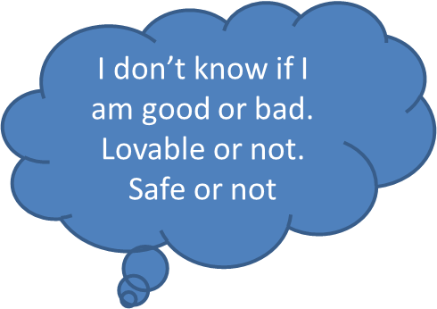
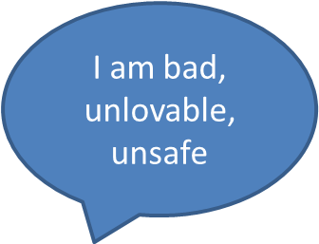
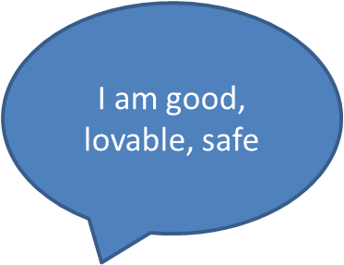
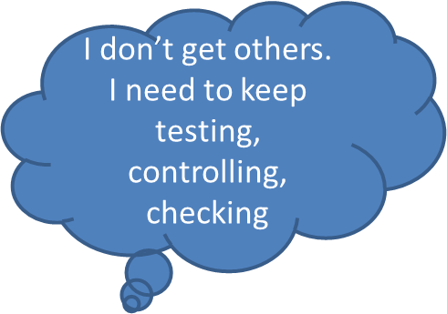
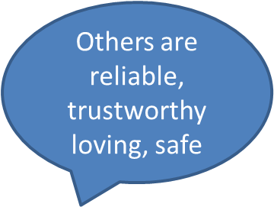
Self concept: Internal Working Model
Notes:
There are 3 patterns of insecure attachment,
Avoidant attachments
Ambivalent attachments
Disorganised attachments
… each has an impact on how your child might respond to your parenting. Remember , their internal working model means that they are likely to see you parenting through the lens of their previous experiences i.e. if they were rejected, they will anticipate that you will also reject at some point – even though you know you won’t. This is the tough bit, its painful if your child can’t experience parenting in a way that makes them feel safe, and loveable. It’s why we tend to talk about re-parenting. You are parenting a child who has already learnt what to expect. It means your child has to unlearn, and then relearn what it is to be parented – this can take a long time for some children.
It also means that what your child needs from you, and others, may be different from other children in your family or friendship group. There’s a great video made by an adoption support organisation called The Open Nest called Brighter Thinking that might help you to understand some of these differences and to explain them to your friends.
https://vimeo.com/121014535
There are some useful resources from Beacon House which are available on their website

Slide 15
Avoidant attachment styles
Avoidant infants and children have experienced parenting that
Was rejecting of their emotional demands
Was intrusive/ insensitive to their needs
Devalued their feelings
Gave the message “don’t make a fuss – be self-reliant”
Didn’t support exploration and co-operation
Was not conducive to building their self-esteem
Babies and children adapt to this kind of caregiving by shutting down on their feelings, deactivating attachment behaviour and relying on themselves.
Notes:
The child’s internal working models mean that they will anticipate that any subsequent caregivers will behave towards them in the same way, and this despite the parenting that is actually be given.
They will respond to what they anticipate, not what is actually happening. That’s why mind mindedness is important – you have to put yourself in their shoes and try to understand what is going on from their perspective. Like the bunch of flowers – it can be kindly meant, but you might experience it as a threat depending on your previous experiences.
Its also important to remember that when parenting style changes e.g. when children are fostered or adopted, they may be more safe, but feel less safe because they can no longer predict what the caregiver is going to do next,
However maladaptive their behaviours were to the previous poor parenting, ambivalent and avoidant children did know what to expect and how to get their needs met within that framework of relationships.
Some examples of behaviours include:
A child who steps on a sharp object but emits no pain and does not seek comfort. It is possible they have blocked their sense of pain as they were left too long feeling stressed as a baby.
A child who is taken on holiday to a theme park with rides and shows no reaction until the end when they have an outburst of rage, tears etc…it is possible they have been in a state of anxiety all the time and have to let it out once they have returned to the familiar. They have not been able to communicate this anxiety earlier.
Often the avoidant child is good in school where they can concentrate their mind on tasks that require ordering, sorting, maths, science etc. as these do not require the involvement of feelings. They will be less able to express themselves when asked to be creative or write expressively.
As they develop avoidant infants and children may show the following characteristics:
Anxious, dependent but shut down on feelings
Deactivate attachment behaviour but anger can burst through
Do not understand emotions, especially mixed emotions in self and others.
Poor perspective taking, empathy.
Cannot reflect/ manage / regulate emotions and behaviour.
Rational but rigid thinkers
Can be socially awkward
Can be bullies when anger at rejection and a lack of empathy for others people combine
Low self-esteem/ confidence but can be boastful and grandiose
Low self efficacy but can be controlling
Risk of antisocial behaviour/ conduct problems.
May have sensory processing issues as they can shut down, or confuse sensations.
Sometimes this type of behaviour means that these children's needs can get misunderstood. As they may not express their needs, they are seen as coping, or doing well, when in fact they are shutting down in a stressful situation.
There are a number of authors that we find useful when thinking about the links between attachment styles and behaviour
Kim Golding gives some interesting real examples in her book Nurturing Attachments.
Gill Schofield and Mary Beek talk about the link to behaviour for all ages of children in The Attachment Handbook for Adoption and Fostering (CoramBAAF, 2016). This is also reflected in the Secure Base model.
Vera Falberg wrote a book The Child’s Journey through placement which many still find useful (1994 BAAF)
Sarah Naish is an adopter herself and many people find her materials useful. For example her book ‘The A-Z of Therapeutic Parenting’
Louise Bomber looks at the implications in school.
Beacon House have developed great on-line materials

Slide 16
Ambivalent attachment styles
Ambivalent babies and children have experienced parenting that is:
Insensitive and only intermittently available
Uncertain and unpredictable
Sentimental, but the adult is preoccupied with their own emotional concerns
Not supportive of exploration and co-operation
Not conducive to building the child’s self-esteem
Preoccupied with anger
Infants and children adapt to this kind of caregiving by hyper activating their attachment behaviour and making constant demands in the hope of getting care and attention.
Notes:
Children who are anxious/ambivalent can be describes as ‘wearing their heart on their sleeve’.
Whereas the avoidant child can concentrate on school tasks, this child will be more focussed on how they are feeling. They may not be able to concentrate on learning because they are overcome with these feelings.
Another example may be a child who is very clingy but never seems to be comforted. This can be very difficult for the carer as they will not feel effective in their effort to comfort the child. As an adoptive parent this can be particularly challenging as you may feel the lack of connection with your child. It is important to believe that this will change over time but that it does need time and repetition. The child needs to change their internal working model, and learn that you will be there for them.
Some children develop some repetitive patterns of behaving which serve to get them attention e.g. a child turning the light switch on and off repeatedly before going to bed, a child who flushed the toilet five times each time, a child who had to return to the doorstep at least six times before eventually walking to school. It is possible these little behaviour patterns are what the child needs to process information. The time and pattern of these behaviours may be a symptom of them needing to deal with their anxiety which they cannot communicate in any other way.
Schofield and Beek (2018) outline that ambivalent babies and children may show the following characteristics:
Anxious and dependant
Shows of emotions/ attachment behaviour
Do not trust reason – rely on emotions
Cannot reflect on/ manage/ regulate emotions and behaviour
Seek relationships but are socially at risk because they are demanding/ needy
Can be victims of bullies – when neediness, anger at rejection and a lack of empathy for others combine
Show low self-esteem/ confidence but seem bright and lively at the same time
Show low self efficacy – can be coercive during pre-school/ middle school years, using extremes of feelings to control.
Are at risk of internalising problems, depression.

Slide 17
Disorganised attachments
Disorganised infants and children have experienced parenting that is:
Frightened or frightening
Insensitive and unavailable
Helpless or hostile
Intrusive
Not supportive of exploration and co-operation
Not conducive to building self esteem
Negative about the child and the self
Caregivers who are frightened or frightening leave the infants with an insoluble dilemma – if they approach their caregiver for security or safety, the caregiver is experienced as frightening rather than protective.
Parent who should be source of safety is also threat – this leaves child with no effective strategy to deal with anxiety or stress
Notes:
So what's going on?
Attachment behaviours drive children towards their caregivers to get their needs met. In secure, insecure ambivalent and avoidant attachment relationships children get close to their care givers and so they feel safe. Even if the caregiving is inconsistent i.e. avoidant children gain proximity by tamping down their needs, being ‘good’ and making few demands of their care givers.
In ambivalent relationships children gain proximity by escalating their needs – clamouring for attention but not being soothed when they receive it.
These children had adapted their behaviour, so called maladaptive coping mechanisms, in order to be close to their caregivers.
If children approach caregivers who are frightening, or frightened, they cannot resolve the issue of feeling safe by gaining proximity. They feel unsafe, hence they have no organised strategy for feeling safe. They experience a push towards their caregiver (attachment behaviour) and a simultaneous pull away (fear).
Children with disorganised attachments cannot concentrate, have poor peer relationships, tend to be aggressive. At home they may be very controlling or they may parent their parents – role reversal. Disorganised children have an internal working models that tell them they are unlovable, bad, unloved and helpless. Their internal working models lead them to perceive others as hostile and/or helpless, and it tells them that relationships are unpredictable and frightening.
As they develop disorganised babies and children are likely to show a combination of some of the following characteristics:
Unable to identify their own emotions, or those of others.
Poor emotional scaffolding i.e. they find it hard to learn by building on previous experiences
Verbal deficits
Poor affect regulation
Low self-esteem? Self-confidence
Dissociation
Poor relationships with peers – withdrawal/ aggression
Hypervigilance in the presence of distress, aggression and violence
Fear and aggression
Punitive and controlling
Conduct disorders
Low novelty seeking threshold
Rigid ad/or incoherent thinkers when stressed
Reading problems
Withdrawal and avoidance, especially neglected children
Poor sense of humour, low positive affect
Unempathetic
Risk of anti-social behaviour/ conduct problems,
Disorganised attachment is far more common among maltreated children, but not all disorganised children have been maltreated. However, disorganisation and maltreatment together present a high risk to child’s healthy psychosocial development. Children with this attachment style are over represented in the population of children who become looked after. Their needs can be really complex and many people looking after children with this level of need benefit from having additional support at some point in their development. It can help you to keep doing a good job by ensuring that you stay stable and grounded whilst caring for them – it’s a way to stay strong! Look at the Looking After Yourself module. Lots of people think that asking for support means you aren’t doing a good job – you will be – its can just be really tough at times!
Discussion: Knowing that your child has experienced abuse in the past can be really tough. What are your strategies to look after yourself?
Scott King from the Section 30 Training agency describes this well.
Some examples of behaviours:
a child who is aggressive in the playground with other children, a child who is hurtful to animals. It is possible the child has witnessed an adult being aggressive as a role model for how they get their needs met so they have learnt this way to behave as a strategy too.
there is also the example of a child who is unable to act independently but needs encouragement to do every little thing like dressing themselves. This is a child who has learnt that it is best to ‘freeze’ to avoid the possibility of being put in a fearful state again by the adult. More later about the impact of fight, flight , freeze.
A lot of children will demonstrate the need to be in control of their environment so they may be the ones who will always lead the play with other children, they will dominate and sometimes bully in order to keep control of the situation.
They may be the watchful one in the classroom, distracted by whoever comes in the room as they need to check out who they are. They may be the over friendly child who approaches everyone who comes into the home and seeks information about them straightaway. In this way they are keeping themselves safe.

Slide 18
What does this mean for our family?
It’s worth remembering that many people have insecure styles and lead perfectly happy and successful lives.
Many adopters find that they parent differently once they start thinking about their child's attachment style because they start to explore and understand
how does their child use them, as their attachment figure, to feel safe.
what is it about their caregiving that triggers the childs defence mechanism?
why does the child always seem to need to be in control?
why is it sometimes that how the child is behaving doesn’t seem to be related to what's actually happening?
Notes:
Reference: Schofield and Beek
There is also a new term called Earned secure attachment. This is evident in those adults who despite early adverse experiences have become aware of their early attachment patterns and have learned to relate closely with an adoptive or foster family.
Adopters (and foster carers) whose parenting is informed by a knowledge of attachment based approaches say that once they start to relax and accept the child's needs, they focus on their parenting approach and not the need to change the child.

Slide 19
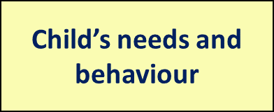
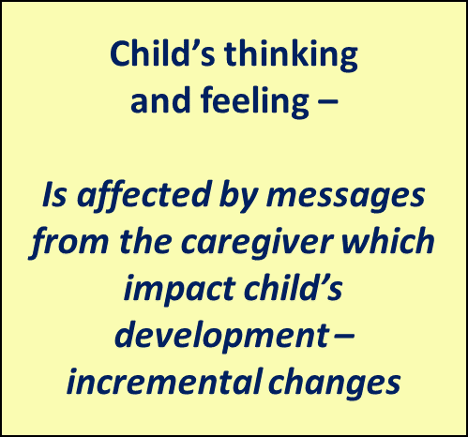
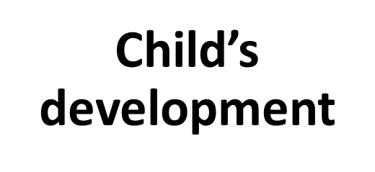
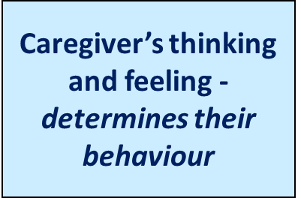
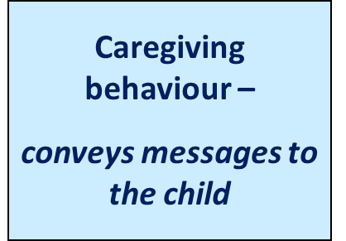
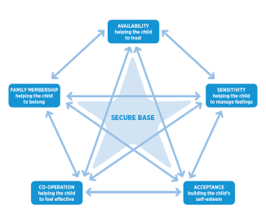
The caregiving cycle
Notes:
Each interaction conveys something to the child, there is an incremental effect.

Slide 20
A health warning!
It’s important to recognise the distinction between the ‘attachment style’ and ‘attachment disorders’. They are different things.
Attachment styles describe patterns in relationship formation.
Attachment disorders are clinical mental health conditions that need to be diagnosed by medical practitioners.
If you are concerned about a child’s mental health it’s really important to talk with people in your adoption support service and your medical service – start with your GP.

Slide 21
Attachment across the Population
Across the populations the spilt in attachment styles is reported as being
59% people have secure attachments
25% avoidant attachments
11% anxious attachments
The figure for people with disorganised attachments styles is therefore around 5%, however it rises to about 80% when you look at children who have been abused.

Slide 22
Managing stress
Early caregiving relationships are the way in which babies learn to regulate stress.
When an baby has a need, and usually they then cry – they have an increase in their levels of adrenalin and cortisol - that’s a stress response.
The baby’s crying will evoke a stress response in an attached caregiver – so they will produce adrenalin and cortisol too.
When the caregiver responds – the baby is fed, rocked, soothed etc - the caregiver calms i.e. their adrenalin and cortisol levels reduce.
The baby’s body response mirrors that of the caregiver ie their adrenalin and cortisol levels reduce, and they are calmed.
In this way our bodies learn to regulate stress.
Notes:
There's more about this in the health and development course.
See Ed Tronick video on Still Face
https://www.youtube.com/watch?v=apzXGEbZht0
There are therefore clear implications for children who did not learn to regulate their physiological stress reaction. Long term with elevated levels of adrenalin and cortisol – so called developmental trauma.
Nadine Burke-Harris describes the impact of what she calls toxic stress on the developing child. Her book links the research on Adverse Childhood Experiences (ACEs) with her own medical practice and research on stress. In this she highlights the potential long term effects on the physical and emotional health from stress. Nadine Burke-Harris: The Deepest Well
She recommends:-
Sleep​
Nutrition​
Exercise​
Positive relationships ​
Meditation/ mindfulness​
Therapy ​
Kate Cairns also write usefully about this area. She is a researcher and consultant, but, with her family offered permanent care for 13 children and is very aware of the caregivers lived experience of parenting traumatised children. Reference Kate Cairns: Attachment Trauma and Resilience
​Similarly Sarah Naish provides a well informed and practical approach to reparative parenting. ​Sarah Naish: The A-Z of Therapeutic Parenting

Slide 23
Reparative parenting
Its vital to remember that well informed therapeutic reparenting can really help children and young people live with the impact of poor early years experiences – that’s what you are doing!
‘It’s really good to understand why our children behave as they do. Knowing about attachment helped me to adapt my parenting and my expectations became realistic. It took time, but it really did work out for us as a family”
Adoptive parent
Notes:
So back to the question of what does this mean for your family?
Thinking in this way means that we can start to respond appropriately to the need (i.e. the child's early unmet needs) that are driving the behaviour in the here and now.
You can focus on thinking about the child's internal working models – how is this informing their beliefs about themselves and others?
Once we start to think about a child's physical, emotional, cognitive and social development, we can respond to children in a holistic way.
It can also help you to think about how your child manages stress.
Lots of people are looking to offer support and information through books, web pages, blogs and YouTube. It’s important that you find someone whose approach suits you. You might do that by following up some of the references in this course, or talking to other adopters or your adoption social worker. Just don’t be afraid to ask for help. The adopters involved in preparing this course really wanted people to understand that things can be tough .Keep their advice in mind.

Slide 24
Key messages
This was what they wanted you to hear …….
Do look for information,
don’t be scared to ask for help
Do look after yourself!
“I found it helpful when someone said ‘Aiming for perfection is not good enough; good enough is good enough’”
That's ok – we don’t always get it right – after a tough day, just remember that you can start again tomorrow!

Slide 25
Summary
Knowing about attachment theory can help suggest different way of parenting that adoptive parents find useful.
The driver for the behaviour may not be in the here and now. It could be
something that the child anticipates because of their prior learning about how caregivers will respond
a feeling they experience e.g. they may feel unsafe because they cannot use caregivers to help them feel safe
A feeling that they are unable to regulate.
Positive, responsive caregiving is always a good thing for children, even though they might not always show you this through their responses.

Slide 26
This course is part of a series developed by the National Adoption Service to support adopters after approval.
These can be accessed at the National Adoption Service website.
Please talk to your adoption support team for further information

