Slide 1
Achieving More Together / Cyflawni Mwy Gyda’n Gilydd

Slide 2
The NAS Post Adoption Training and Development Framework
These materials have been developed for the National Adoption Service for adoptive families
Their purpose is to provide a learning and development resource for adopters post placement
These tools can be used by groups or by individuals.
There is lots of information in the notes below each slide so it is important to read these too as they provide much more information, and some useful ideas for more reading.
Notes:
These courses may be useful for professionals but their primary audience is adopters, and their families.
We have tried to include sufficient information for those self learners looking at this on its own. However if the material doesn’t seem to ask your adoptions support team for some help in getting to grips with the issues.
By its very nature a short course will never cover all that is known on a subject. The courses have been developed by experienced social workers and adopters who have pooled their thinking about what might be useful. There is always more to know, and some authors who will seem useful to you, others less so.
Try out some new thinking but if it’s not helpful ask other people for ideas and other training courses, books etc– friends, colleagues, other adopters, helplines, your adoption support service. By reading around you will come across someone who talks to your experience.
If delivering as a course, consider
using an ICEBREAKER
how you will deal with INTRODUCTIONS (of yourself and participants) – e.g.. Round room, introducing one another, show of hands
Whether a REGISTER needs completion
Whether BADGES will be used
HOUSE-KEEPING/GROUND RULES (e.g. fire drill, fire exit, refreshments, parking, mobile phones, confidentiality, safe-guarding, let everyone speak, everyone is entitled to their opinion, timekeeping, opportunities to ask questions/discuss)
Arrangements you will have in place if a participant becomes DISTRESSED or needs to leave the training room if they are finding the topic emotive
If delivering on a one-to-one basis consider
GROUND RULES (e.g. confidentiality, safe-guarding, everyone is entitled to their opinion, timekeeping)
Explain course in context of the other 2 hour courses in the National Adoption Service online training suite and wider training/support available in Wales for adoptive families

Slide 3
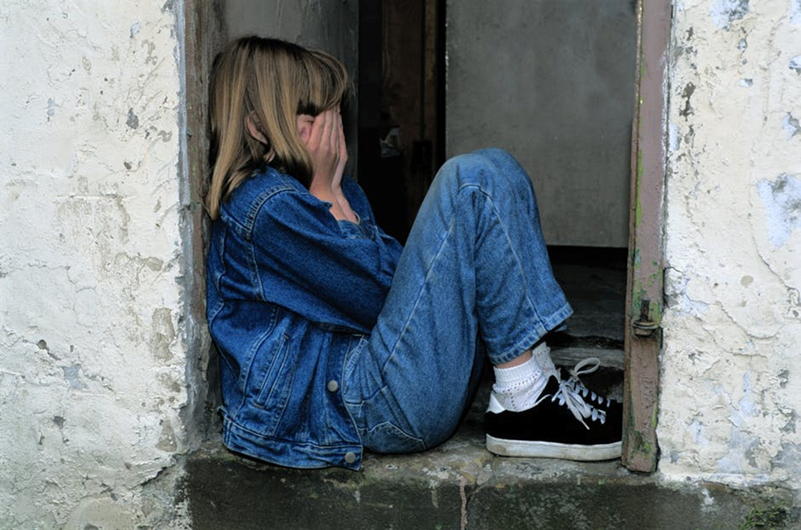
Living with Challenging Behaviour

Slide 4
Learning Outcomes
By the end of this course, participants will have:-
Considered how they define challenging behaviour
Reflected on the unmet needs beneath challenging behaviours
Identified a range of strategies to address challenging behaviour
Notes:
This online course provides an introduction to the reasons behind challenging behaviour and introduces some strategies to address certain behaviours. It is not aimed to replace a more strategic approach to addressing challenging behaviour issues (e.g. Attending a longer courses, therapeutic input, support from CAMHS, etc.)
It’s important to recognise that due to early trauma and other issues (e.g. Attachment issues, ADHD, autism, Foetal alcohol spectrum disorders) the behaviour adopters are dealing with is often over and above that faced by other parents – in terms of frequency, intensity and the length of time it takes for a child to calm down.
It can feel like no one knows what to do when this happens to you – sometimes the approaches suggested just don’t work for your adopted child.
You may feel under scrutiny, and as if you just need to keep your cool and buckle down.
Depending on your child’s age and stage of development, some traditional parenting techniques may work well in terms of managing certain behaviours. However as adopters we recognise that it is important to have a range of approaches in your “tool box”.
This course features some of Bryan Post’s approaches however your “tool box” is also likely to include elements of PACE (Dan Hughes’ Dyadic Developmental Psychotherapy), Non Violent Resistance and other approaches to managing behaviour.
If you are offered places on a “universal” parenting course (e.g.. Webster Stratton “Incredible Years”) it is worth attending to understand the many parenting strategies that are available to us and also to meet other parents. However the work of Bryan Post, Dan Hughes and others is more specific to supporting children who have experienced significant trauma, in particular separation from birth family.
It can be tricky – what works for one child may or may not work for another child, even within the same family.
Sometimes despite our very best efforts our children will sometimes revert to their challenging behaviours when they are particularly stressed. If there aren’t always answers how do we learn to live with this? It may be useful to read the article “Welcome to Holland” by Emily Perl Kingsley copyrighted 1987 (this can be found via google). It is an excellent article to read to help parents come to terms with things they may feel are organic and that can’t be changed.
It may be useful to read Holly Van Gulden’s book “Learning the Dance of Attachment” to help understand the unmet need beneath the challenging behaviour. This book is a guide for adopters and foster carers to nurturing healthy development. It explains the normal stages of childhood emotional development and contrasts these stages with dysfunctional behaviours caused by early trauma and abuse.
This short course helps us consider the different ways people think and provide some opportunities to try out some strategies. It is not exhaustive!

Slide 5
What lies beneath?
Notes:
Before working through the course, you may find it helpful to do the 2 hour online Health and Child Development course, which is part of this suite of training courses.
The aim of this slide/activity is to start looking at what lies beneath the presenting behaviours.
Take a moment to consider the behaviour you find challenging?
Write your answers down.
Your answers may include aggression, violence, lack of concentration, lying, stealing, self-harming, school refusal, controlling, truanting, food issues.
Now take a moment to consider what do you think are the feelings behind the behaviours you’ve listed?
Your answers might include uncomfortable, insecure, fearful, scared, out of control, helpless, unnoticed, unloved, unsafe.
These feelings are all appropriate and natural.
And now think about what are a child’s basic needs?
Your answers should include comfort, safety, control, attention, affection.
We can summarise a child’s basic needs using “Maslow’s hierarchy of need” which is often produced as a pyramid diagram with “physiological” at the base and “self-actualisation” at the top.

Slide 6
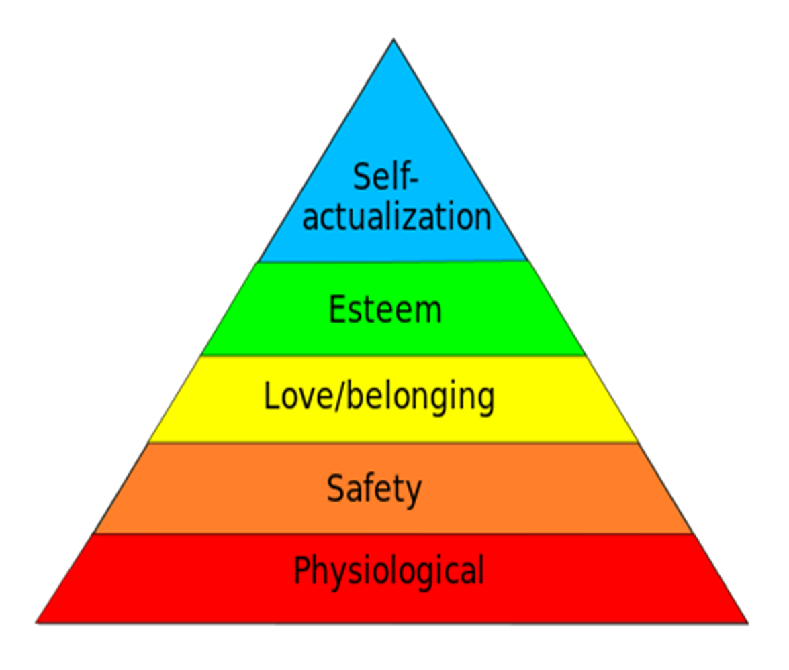
Maslow: Hierarchy of Needs
Notes:
Maslow 1954
This is a significant diagram as it demonstrates the hierarchy of needs starting at the bottom. A child needs their physiological needs met first i.e. To be fed, sheltered, kept warm, held etc. They then need to feel secure. The emotional feelings of love and belonging to a family or social group are next before the child can begin to feel self esteem and then build their sense of self efficacy. This hierarchy can also reflect what we know about how the brain develops. The physical and physiological needs develop first. This can correlate with a child’s brain stem development and their body impulses. The next stage is the feeling of safety and security. Without this in place the child will struggle to develop further. When this is in place it is usually within the context of a loving relationship and the child having a sense of belonging. This is the secure base from which they feel able to explore and learn. This can be seen to correlate with the Limbic brain development as the child experiences emotions. The top two levels relate to the child developing self esteem and competence until they are able to achieve self actualisation, plan ahead and fulfil their ambitions. This requires a good level of cognitive functioning which develops until the mid 20’s.
Self-actualization – includes morality, creativity, problem solving, etc.
Esteem – includes confidence, self-esteem, achievement, respect, etc.
Belonging – includes love, friendship, intimacy, family, etc.
Safety – includes security of environment, employment, resources, health, property, etc.
Physiological – includes air, food, water, sex, sleep, other factors towards homeostasis, etc.
(homeostasis = the ability or tendency to maintain internal stability in an organism to compensate for environmental changes)
The behaviours you listed at the beginning are inappropriate responses to appropriate feelings.
We need to “think safety first” – ask yourself “is the child feeling safe?” “is the child feeling afraid?”.
Development happens in stages, parents are vital in helping a child develop. The brain always checks for “safety first” (may be useful to refer to the 2 hour Child Development course at this point)
USEFUL READING - Viv Norris’ book “Parenting with Theraplay”
Quick think – What causes the inappropriate behaviours?
We’ve thought about the feelings and needs, so why do our children use these inappropriate ways of showing us those needs and feelings?
Your responses might include
Medical factors (eg. Prematurity)
Family environment
Community influences/situational factors (eg Multiple Care givers)
Genetic make-up/personality characteristics/temperament (eg ADHD)
Brain development/physical, emotional, social, cognitive development

Slide 7
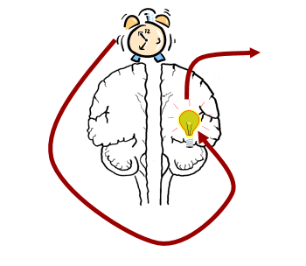
The trauma response
By-passes the left side
Disconnected Response
Fight
Flight
Freeze
terror
shame
fear
Notes:
The reason some adopted children show their feelings in inappropriate or unexpected ways is because they have experienced early trauma and neglect which has “wounded” their brains and neural pathways.
Their brains have been affected by this trauma which causes them to feel overwhelming terror, shame and fear when faced with certain triggers – for example smells, physical feelings, visual triggers, tastes, sounds, etc. These triggers can cause their trauma to be re-triggered.
So rather than be able to use their “thinking brain” (pre-frontal cortex) to consider an appropriate response, or their limbic system (amygdala and hippocampus) to allow for appropriate emotional regulation, they will kick into survival mode and go for a fight, flight, freeze response .
USEFUL READING “What Every Parent Needs to know” by “Margot Sunderland” – refers to “thinking brain”
USEFUL YOU TUBE CLIP https://www.youtube.com/watch?time_continue=193&v=xPjhfUVgvOQ which features Dan Siegel explaining the function of the left and right sides of the brain and how mindfulness can help.
Left brain functions: Responsible for control of the left side of the body, and is the more artistic and creative side of the brain.
Right brain functions: Responsible for control of the right side of the body, and is the more academic and logical side of the brain.
We should try to respond to the inappropriate behaviours that are expressions of appropriate feelings in two ways – Approach or Avoid

Slide 8
Responses – Approach and avoidance
The responses to unexpected or inappropriate behaviour are present in both PARENT and CHILD
The defensive facial ‘look’ and words of the child can be met with the parent’s left brain “ I wonder why…” to prevent emotional defensiveness in the parent and to encourage engagement in the child.
Notes:
We need to be training our brains and our child’s brains to avoid the behaviour and approach the need/feelings.
It is the feelings and unmet need we are responding to and approaching, NOT the behaviour itself.
We can choose to look past or not react to (i.e. “avoid” being drawn in by) a child’s defensive facial “look” and what is coming out of their mouths (shouting, screaming, swearing) by approaching the underlying behaviour using Dan Hughes’ strategy of “wondering” out loud. For example “I can see that you are getting all hot and bothered and raising your voice, I wonder whether you are feeling sad because no one played with you at break-time in school today?”
By approaching in this way, we are preventing emotional defensiveness in the parent and encouraging engagement in the child – we are not responding to the shouting and swearing but to the sadness.
This approach helps to sculpt the developing brain – and remember the brain develops and changes throughout life, and particularly into the mid 20’s.
USEFUL READING “Brain Based Parenting” by Dan Hughes and Jonathan Baylin and “Building the Bonds of Attachment” by Dan Hughes.
We know stress is a component of the negative effects on the child’s development - neuro-biology shows this (Hughes and Baylin),
AND we know that well meaning but stressed parents will suppress their ability to sustain loving feelings and empathy towards their child.
Parenting can be hard and stressful at times. You might find it useful to take a look at the 2 hour online session on “Secondary Trauma and Blocked Care”.
At times we are all challenged to keep our lids on! It would be really useful to look at this clip from Dan Siegel which explains the science behind “flipping your lid”.
https://uk.video.search.yahoo.com/search/video?fr=mcafee&p=you+tube+flipping+lid+dan+siegel#id=2&vid=bbf522d026a5630d5a75bd845f282037&action=click
If a parent can take the therapeutic role by accepting the child for who they are and their behaviour as the language of their past, the parent can reframe their thoughts to accept that “It isn’t my child’s fault… and it isn’t mine either!”
We are in Hughes territory: of PACE – Playful Accepting Curious Empathetic responses.
PACE focuses on the whole child, not simply the behaviour. It helps children become more secure with adults and reflect upon themselves, their thoughts, feelings and behaviour, building the skills that are so necessary for maintaining a successful and satisfying life. The child discovers that they are doing the best that they can, and are not bad or lazy or selfish. Problems diminish as the need for them reduces.
Through PACE and feeling safer, children discover that they can now do better. They learn to rely on adults, particularly their parents, and trust them to truly know them. They learn that their parents can look after them in a way that they could never do on their own.
When children experience the adults doing the best they can to understand them and trying to work out together more effective ways for the child to understand, make sense of and manage their emotions, thoughts and behaviour they start to believe that the adults really will keep on trying until things get better for all of them.
For adults, using PACE most of the time, they can reduce the level of conflict, defensiveness and withdrawal that tends to be ever present in the lives of troubled children.
Using PACE enables the adult to see the strengths and positive features that lie underneath more negative and challenging behaviour.
(The above information on PACE is adapted from the DDP Network website https://ddpnetwork.org/about-ddp/meant-pace/.
USEFUL YOUTUBE CLIP from Sarah Naish explaining “naming the need”, Dan Hughes PACE and therapeutic parenting https://www.youtube.com/watch?v=Y-oWUZNhEXo

Slide 9
Trauma and the fear barrier
Trauma will cause the child to revert to an age when they experienced early trauma
A trigger may take the child back to the past trauma
Bryan Post calls this the ‘fear barrier’
Adolescents may behave like toddlers
Adults can behave like adolescents
They will act their emotional age, not their cognitive age or chronological age
(based on Bryan Post’s “The Great Behaviour Breakdown”)
Notes:
Let’s look in more depth at these trauma and fear-based responses.
We often talk about addressing a child’s EMOTIONAL AGE rather than their CHRONOLOGICAL AGE because they have missed out on chunks of their development (you may wish to refer to the 2 hour Child Development Course).
The way we respond to a toddler who is crying because they have nappy rash and want their nappy changed may be very different to the way we respond to an eight-year old who is still wetting the bed; we need to respond to that 8 year old’s EMOTIONAL age.
The way we respond to a toddler who has thrown his food on the floor from his high chair may be very different to the way we respond to an 11 year old who picks his food up and throws it at the walls and ceiling. We need to “think toddler” and respond, rather than react, to this behaviour. This child may be processing something difficult that happened at school or reacting to something that’s been said to him while he’s eating his meal e.g. “as soon as you’ve finished your food you need to do your homework”. After eating a toddler may well have a cuddle with one of his parents or sit down and have some quiet time with them reading a story; your 11 year old child is showing he wants attention and engagement rather to sit in another room doing homework.
USEFUL READING “Great Behaviour Breakdown” by Bryan Post – pages 29-34
USEFUL READING On Page 21 of “Teenagers and Attachment” (edited by Andrea Perry) we see that “Insecure-disorganised attached children can present as belligerent and even violent. They expect support but it won’t be enough for them and they break closeness, express rage. They may be unpredictable, provoke shouting matches at home or at school. At school their learning comes second to fears about who cares for me, and who will reject me, or who do I have to beat up before they get me? Their seeking for an attachment figure is thwarted by their behaviours”
USEFUL READING “From Fear to Love” by Bryan Post

Slide 10
Causes of ‘anger’
Bryan Post tells us that what we see as anger is really fear which causes dysregulation
If we don’t recognise this children can become frustrated, angry with themselves and then others
Fear arises under stress
We see it in situations like:
Lying
Transitions
Stealing
Notes:
USEFUL YOUTUBE CLIPS:
You may wish to look at online clips by Bryan Post, Sarah Naish and Christien Moers from YouTube – for example:-
Bryan Post Lying and Stealing - https://www.youtube.com/watch?time_continue=12&v=rHlJEr4ebM0
Christien Moers Lying - https://www.youtube.com/watch?v=iDnEy8Rn4fY
Sarah Naish Stealing - https://www.youtube.com/watch?v=JMBtepk_MZE
USEFUL READING:
The following books are written by Sarah Naish to help parents talk with children about issues including stealing, lying and their feelings
“Charley Chatty and the Disappearing Pennies”
“Ellie Jelly and the Massive Mum Meltdown”
“William Wobbly and the Very Bad Day”
“Rosie Rudey and the Very Annoying Parent”
“Katie Careful and the Very Sad Smile”
“Rosie Rudey and the Enormous Chocolate Mountain”
“Sophie Spikey has a Very Big Problem”
“Charley Chatty and the Wiggly Worry Worm”
“Williams Wobbly and the Mysterious Holey Jumper”
“Callum Kindly and the Very Weird Child”
Sarah Naish’s A-Z of Therapeutic Parenting is also a really useful “dip into” guide providing a model of intervention and easy to follow strategies to use when responding to issues with children. The A-Z covers 60 common problems parents face, from acting aggressively to difficulties with sleep, with advice on what might trigger these issues, and how to respond.
Bryan Post’s books “From Fear to Love” and “The Great Behaviour Breakdown” are also designed to dip into to find advice on specific issues and learn more about why the issues happen and how to respond. Below is an example of what Bryan Post has to say about Lying:
LYING:
Comes from a state of survival -the child must persist with the lie at all costs in order to survive.
Lying is a fear reaction to protect oneself
Easily creates a fear reaction in the parent.
Is a fear-based behavior; a threatening reaction from the parent only feeds into the child's fear.
When finding your child in a lie, recognize that:
Lying stems from a state of stress.
The lying behavior is not directed at you personally. Your child is reacting from past trauma experiences.
Your child already feels threatened, so confronting the lie will only heighten and create more threat.
Your best response is to "ignore the lie, but not to ignore the child."
Your child cannot be taught the moral lesson of lying while in the act of lying.
Your child's foundation is insecure and your child needs your help in building the parent/ child relationship through a non-blaming,
non-punitive environment.
May wish to refer to “Great Behaviour Breakdown” by Bryan Post chapter on Lying
Post’s 3 rules around coping with behaviour issues around lying are:-
1 Ensure the child is safe. Especially if its school term, make sure they are safe at school
2 Give the child 10-20 mins of quality time each night to let the child talk about anything or nothing. Be WITH the child.
3 If a child has lied, ignore the lie but don’t ignore the child. Because the lie comes from dysregulation. Instead, hug, tell the child you love the child and reassure the child allow the child to re-regulate. Address your own dysregulation .This avoids entanglement with one’s own emotional past/ reactivity.
When both you and your child are calm – perhaps an hour or so later, parent can say “ Hey, when you tell me a lie, it really hurts me.” DO NOT INSIST that the child tells the truth ! Or the result will be another lie.
TRANSITIONS
Refer to chapter in “Great Behaviour Breakdown” on Transitions
Change is a huge problem for most adopted children: adopted children first developed a fear of change during the first transition when removed from their birth family even if that family was neglectful or abusive.
Post refers to the example of the child who “poops his pants” and concludes this soiling behaviour is based on his fear of transition and change - ANY change.
Post suggests the child will be helped by bringing the unconscious into the conscious “Great Behaviour Breakdown” p64.
STEALING:
Is an external attempt to soothe an internal state.
Is an addictive behavior which produces a sense of relief (which his momentary) often resulting from a reduced sense of safety producing stress.
Becomes repetitive because of the internal payoff. Repetition changes the brain so the stealing becomes a conditioned response to a stress state.
When discovering your child has stolen, recognize that the child needs you to keep them close to you in that environment; limit their space and create containment for them.
Explain to the child the dynamics of the stealing behavior; communicate to the child about why they steal and that stealing makes the child feel better.
Explain to the child you are not coming from a blame-based perspective, but that you are coming from a place of taking responsibility for them.
Address the root mechanisms that lead to the behaviours and reach the child in the deep emotional place that drives this behaviour.
Teach the child how to communicate to you when he feels like stealing, saying, "I need to know how you feel when you go into a shop. Help me to understand."
OTHER USEFUL READING “Thinking Psychologically about Children who are Looked After and Adopted: Time for Reflection” by Kim S Golding
NB this course can only touch on some issues and cannot cover more acute mental health issues or extremely challenging behaviour – eg. Self-harm, food issues. This course provides a formula - you need to identify and respond to the NEED that the child is presenting with.

Slide 11
Anger is a defence against low self-worth and fear of rejection
Children may:
Blame others (parents/siblings) but not themselves and become angry with the people they blame
Reject parent before being rejected
Be saying by their behaviour “This is how bad I am – will you still love me?”
Be expressing frustration if things are out of control
Be using anger to manage difficult feelings – anger blocks sadness
Notes:
USEFUL READING – text in this slide is taken from Kim Golding’s publication “Nurturing attachments” page 139

Slide 12
Aggression
Many adopters have first hand experience of their children’s fear which causes hyper-arousal
We see …
parents threatened with knives
cruel and offensive language
fights with siblings
trouble at school
destruction
Notes:
USEFUL READING
You may wish to refer to the section on AGGRESSION in “The Great Behaviour Breakdown” by Bryan Post, Pages 75-82
A child can be desperate for regulation. Because of their intense stress they seek ways to get out of the stress they feel. In effect they can’t express their true feelings and need help to regulate them. In contrast with the conventional view to ignore the child, the parent should offer the child undivided attention. Imagine a child has thrown his football boots down the stairs and smashed your favourite vase. The therapeutic response (as opposed to your reaction) might be “I can see you are feeling scared. I wonder if it’s because your were worried we’d bump into your birth Dad at the football match? I didn’t realise he used to take you to football matches when you lived with him. Let’s go in the garden and see who can bounce the highest on the trampoline”.
In the example above the child is desperate for regulation but has become hyper-aroused due to his feelings of sadness and fear around possibly bumping into his birth dad at a football ground. Perhaps the adoptive mum didn’t realise this was a trigger until AFTER the event. In this example she’s ignoring the behaviour (which could be destruction, threats to injure, getting into trouble at school) but addressing the feelings (fear and sadness) and the underlying need (for regulation – Mum can keep me safe, she has in the past and she will in the future).
The child can be invited to express his anger and what he feels he NEEDS. He is invited to practice telling what he needs and feels. The parent may also want to tell the child about times when he/she has felt sad and scared about something. Describe what was going on in your head at that time but also how it felt in your body – e.g. “my skin started feeling prickly; my neck started going red; I kept fiddling with my earrings”. We are given the child the tools they need to identify tell tale physiological signs that they are getting stressed, before it erupts into inappropriate reactions.
In some situations the Amygdala in the brain is triggered to freeze (rather than “fight” as in the example above, which we would describe as hyper arousal). The child will freeze before moving into their ‘preferred state – hypo or hyper. Children can move back and fore between hypo and hyper vigilant states. Meryl Lee explains “freeze” and hypo-arousal state clearly in this link http://www.shellsnbells.com/pdf/WorkingWithHypoArousal.pdf.
Hypo-arousal can look very much like depression. The child may struggle to express any emotion, is likely to have very low energy, may sit with their shoulders stooped and have little or no enthusiasm or motivation. It can be an almost perpetual state of being for those who developed avoidant attachment as infants. It may help to encourage the child to experiment with different postures, drawing their feelings instead of talking about them, walking round while doing an activity that they would usually do sitting down (eg. Reading a book). Using “props” like “Bear Cards” to help children express their feelings may help, too. https://www.amazon.co.uk/Bear-Cards-Feelings-John-Veeken/dp/0980517524/ref=sr_1_1?ie=UTF8&qid=1528805782&sr=8-1&keywords=bear+feelings+cards
A child who is hyper-aroused will be continually on guard and looking out for danger. Even when they appear relaxed watching TV, they can suddenly jump up, their eyes will become wide and they will be on high alert. This may have been caused by a slight noise, a rush of wind through an open door, or the smell or a certain food cooking, for example. The child becomes agitated and may perspire and start breathing fast and shallow. Their pulse is likely to be racing. Their ability to think logically, use problem solving or respond appropriately will be severely limited at moments like this.
Children who are hypervigilant will usually find a reason to escape the perceived threat by, for example, running off or out of a room. If this is not possible they can remain in a state of alert and might use a coping mechanism like holding someone’s hand or putting their head under a cushion. In some cases it can be extreme enough for the person to become almost entirely preoccupied with scanning their environment for threats. They may become agitated in crowded or noisy places and may adopt a variety of obsessive behaviour patterns as ways of coping.
There are things you can do to help though. Exercise is helpful as it burns adrenaline and releases feel-good hormones. Showing the child how to relax and take deep breaths can help, and obviously reassure them that they are safe.
In toddlers – at pre school or infant school – the child is likely to need careful supervision with a caring adult to allow the child to regulate. And to maintain this.
In the school child – and perhaps more so in the secondary school child when the scale and number of stressors is higher without the nurturing environment of the primary school setting – the child is stressed out during the day and is retriggered by mum or dad when they get home. At home they might feel they can let go, in contrast to school environment.
In summary
- A hypo reaction is withdrawal/ depression
-A hyper-reaction is arousal to fight.
As with the child, the parent can trip into stress/survival mode. This is explained well in Hughes and Baylin’s book “Brain Based Parenting”.
To understand aggressive outbursts in school, we need to recognized that children can misread social situations, have poor interaction with their peers leading to frustration and then anger – USEFUL READING “Inside I’m Hurting” by Louise Bomber Page 135
Misunderstanding a teacher who says that an answer is “wrong” means for some children “ You are bad” which leads to frustration and then anger (see Bomber “Inside I’m Hurting” Page 227)
BRUCE PERRY says “One of the major problems with these children is aggression and cruelty. This is related to two primary problems in neglected children: (1) lack of empathy and (2) poor impulse control. The ability to emotionally "understand" the impact of your behaviour on others is impaired in these children. They really do not understand or feel what it is like for others when they do or say something hurtful. Indeed, these children often feel compelled to lash out and hurt others - most typically something or someone less powerful than they are. They will hurt animals, smaller children, peers and siblings. One of the most disturbing elements of this aggression is that it is often accompanied by a detached, cold lack of empathy. They may show regret (an intellectual response) but not remorse (an emotional response) when confronted about their aggressive or cruel behaviors”. But these states CAN be changed by therapeutic parenting and routines/boundaries.
You may wish to refer to 2 hour course to help those dealing with aggression “Child to Parent Violence/Non Violent Resistance”
USEFUL RESOURCES for coping with challenging behaviour which is displayed at school “Getting It Right for Every Child” booklets for parents and children – free to download from Adoption UK Wales website https://www.adoptionuk.org/getting-it-right-for-every-child

Slide 13
Re-parenting strategies
Listen, acknowledge, reflect…then relate and regulate
Stop and think
Lower your voice, slow your speech
Make a physical contact if possible
Reflect facts and feelings - match affect
Share comfort
Encourage self soothing
Make more time later
Use praise, especially verbal
Notes:
The strategies on this slide can be helpful in re-parenting traumatised adopted children, because they focus on addressing the un-met needs beneath the behaviour.
Adoption UK’S 6 day “Parenting our Children” course looks in far greater details at parents’ feelings and reactions, children’s feeling and reactions, underlying reasons for behaviour and many strategies and interventions to address these issues.
Bryan POST refers to a THREE PHASE INTERVENTION - REFLECT – RELATE – REGULATE . You can read more about this in his book “The Great Behaviour Breakdown” PAGE 48-51.
REFLECT =“ I feel scared now and I need to know how you feel” {ask your child to tell you more/express more with permission to do so e.g. if he says “ I’m mad right now/ I’m really angry !”
RELATE =AS LONG AS YOU ARE CALM you can say “ Tell me more/ Give me more.”
While saying calm, you help your child express their emotions.
REGULATE = co regulation together, expressing similar feelings, calming down through expression of shared feeling
Regulation and co-regulation are aspects of attunement in which the child experiences the ability to cope with stress, to regulate emotions and to manage impulses (see pages 116, 118 and 119 Kim Golding “Nurturing Attachments”)

Slide 14
Re-parenting to avoid confrontation
Provide consistent parenting
Control routines within the household
Use natural and logical consequences
Be positive with instructions
Consider rewards
Build self-esteem
Build trust - allow control within boundaries
Provide comfort to repair relationship
Provide fun, cuddles, and nurture
Notes:
Below is an extract from Kim Golding’s book, “Nurturing Attachments” page 188 which explains why we need to step away from confrontation and ways in which we can do this
“How to step aside from confrontation”
A child will be confrontational for a number of reasons.
It helps the frightened child to feel in control, thus increasing the child feelings of safety and security.
The confrontation is an effective way of controlling the degree of attention received from the parent. The child might want to keep the parent involved and attending to the child. Alternatively she might want to get some distance into the relationship.
It helps the child displace blame and thus they avoid feeling overwhelmed with shame about not being good enough .
Confrontation represents a coercive pattern of relating to the child. The child coerces the adult into maintaining attention on to the child or becoming distant from the child.
When children are being confrontational they will feel emotionally aroused. Their behaviour is likely to be escalating into an increasingly angry, demanding style of relating to the adults.
Whilst it may not feel like it, you do have a choice in the face of this behaviour. You can either match the pattern of behaviour, also becoming aroused and increasingly angry. This is likely to increase the confrontational behaviour your child is displaying. Alternatively you can remain calm, avoid being pulled into the confrontation, and allow the child to gradually calm down in turn. (NB escalation patterns are covered in detail on Non Violent Resistant courses)
When two people are relating, their emotional patterns will gradually match each other. If the parent becomes angry then an escalating, reciprocal pattern of angry behaviour occurs. If however the parent maintains a calm emo­tional tone the child will calm down as well; angry behaviour de-escalates rather than escalates.
It will be helpful to discuss the re-parenting strategies on this slide with your partner, social worker or a friend/family member. Think about how you can apply them to your own child and situation.
Remember rewards should be small gestures of unconditional love, rather than grand, expensive presents – a reward may just be “let’s sit down and watch your favourite DVD together” or “I’m going to cook your favourite pasta Bolognese for you now, would you like to help me?”

Slide 15
Consequences
Consequences… not punishment
Enforceable, reasonable, proportionate
Natural and logical consequences
Be aware that a hurt or angry child might see consequences as punitive
Notes:
Refer to “Great Behaviour Breakdown” page 33. Discipline has come to mean punishment but the word discipline comes from the word ‘disciple’ – its about teaching. Or rather it’s about the child’s LEARNING.
If your child’s behaviour is the result of stress how can punishment help? It will increase the child’s stress and increase the behaviour you are trying to alleviate.
No teaching will help when the child is in this dysregulated state. They CAN’T learn in this state.
They won’t remember what is said, they will be confused and disoriented.
Consequences are for AFTER the dysregulation not DURING it.
POST in “Great Behaviour Breakdown” page 52-53 says there is a big difference between a parent formulated consequence and a natural consequence. A natural consequence occurs naturally: you cannot control, prevent or avoid them, they occur naturally. They are not taught.
Post believes most consequences are blame and fear based. So they do not teach responsibility.
This is largely the same philosophy that Hughes is beginning to express, when he suggests that the well attached child can accept a consequence because he does not see it as punitive [ because he understands the context and the love within the family] from which it comes. The un-attached child does not GET this !

Slide 16
Natural and Logical Consequences
Notes:
EXERCISE:
Consider this scenario – it is cold outside but your 8 year old child is refusing to put on their coat for school
ASK YOURSELF:
What would you do? (you would probably try persuading the child to wear their coat!)
But what if you said “ok, let’s walk to school without your coat”
ASK YOURSELF:
What do you think the natural consequence would be? (the child is likely to be cold, it might start raining so the child will get wet)
The child may well decide to wear their coat the next day of their own accord to avoid getting wet and being cold.
ASK YOURSELF:
What would a logical consequence be? (examples include – child not allowed out at break time, child not allowed on school trip to library)
The parent has no control over these logical consequences, but school does, so child not likely to feel the need to “punish” the parent)
You might like to consider some of the “battles” you have with your children and think about the natural and logical consequences that will ensue.
USEFUL READING Sarah Naish book “Therapeutic Parenting in A Nutshell” and “a-z of Therapeutic Parenting”

Slide 17
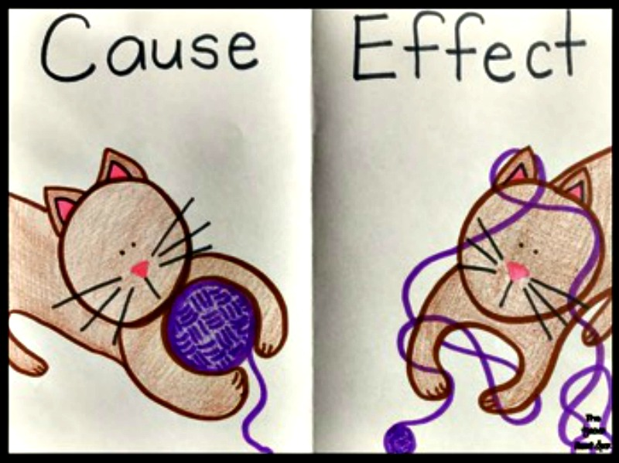
Build Cause and Effect Thinking
Choose your battle
Offer limited choices
When ….. Then
(but not if!)
Give praise with care

Slide 18
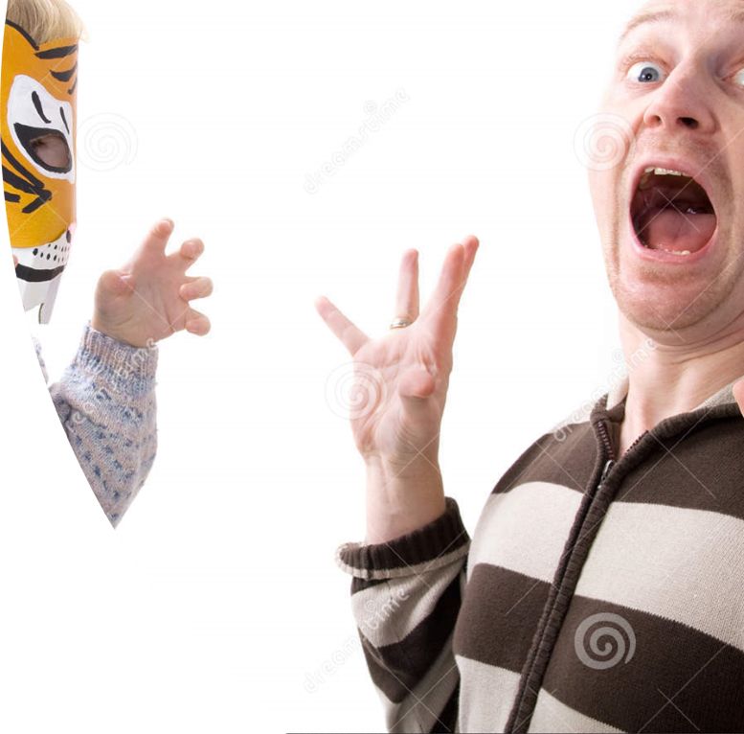
Use shock and surprise
Surprise by over-reacting
Use the unexpected
Use humour and unconditional fun
But don’t be false
Deliver with unconditional love
Notes:
Use these techniques with care; parents know their own children and usually have a good idea about which of these techniques may work and which could cause the child to dysregulate further.
EGS
Over-reacting child has sat colouring quietly for 5 minutes while parent is on the telephone. Surprise the child by heaping praise upon them “I’m SO pleased that you sat so quietly while I was on the ‘phone to Aunty Ann, well done, that was amazing!” (rather than saying “why can’t you be like this all the time, you usually interrupt me constantly while I’m on the phone”) – think emotional not chronological age of child
Unexpected child has thrown a plate onto the floor and it has smashed. Rather than criticize the child for smashing the plate, say “do you know what, when I was so fed up last week about the dentist cancelling my appointment at short notice, I felt like smashing something. I wonder what you are feeling fed up about? I know you’ve got Assembly in school tomorrow and you struggle with that. Do you want to talk about it? Anyway, I never really liked that plate. Shall we go and chose some new ones in Ikea at the weekend?”
Humour and Unconditional Fun child is refusing to put coat on for school on a very cold day. Parent doesn’t comment on the refusal but instead wraps themselves up in the thickest coat they can find, accompanied by a scarf, hat and gloves, then comments “I’m just going upstairs to get another pair of socks in case my feet get cold, I wonder if you can get your coat on before I come downstairs”. If child still refuses to put coat on, make the walk to school fun by saying “come on then, we’re going to jog to school to keep us warm” and starting to jog to school in your most exaggerated fashion! (a natural and logical consequence are likely to follow, too),
It’s important to recognise as parents that we may need to change/adapt our approaches. We can do this be carefully watching how our child reacts and responds. By changing and adapting, we are modelling to our children that it is possible and necessary to adapt/change.
Think about celebrating “one proud moment of the day” every single day, however difficult the day has been!
If you don’t think your child can handle direct praise, think about “phoning a friend” while your child is in ear shot and telling them how proud you are of what your child has done today.

Slide 19
Bruce Perry’s top tips
Nurture your children
Try to understand the behaviours before consequences
Parent your children based on their emotional age
Be consistent, predictable and repetitive
Model and teach appropriate social behaviours
Listen to and talk with your children
Have realistic expectations of your children
Be patient with your child's progress and with yourself
Take care of yourself
Notes:
This slide summarises what this course has covered.
The slide text is bullet points from an extract from the Child Trauma Academy paper “Bonding and Attachment in Maltreated Children: Consequences of Emotional neglect in childhood” by Bruce D. Perry, M.D., Ph.D.

Slide 20
This course is part of a series developed by the National Adoption Service to support adopters after approval.
These can be accessed at the National Adoption Service website.
Please talk to your adoption support team for further information

